Slide 1
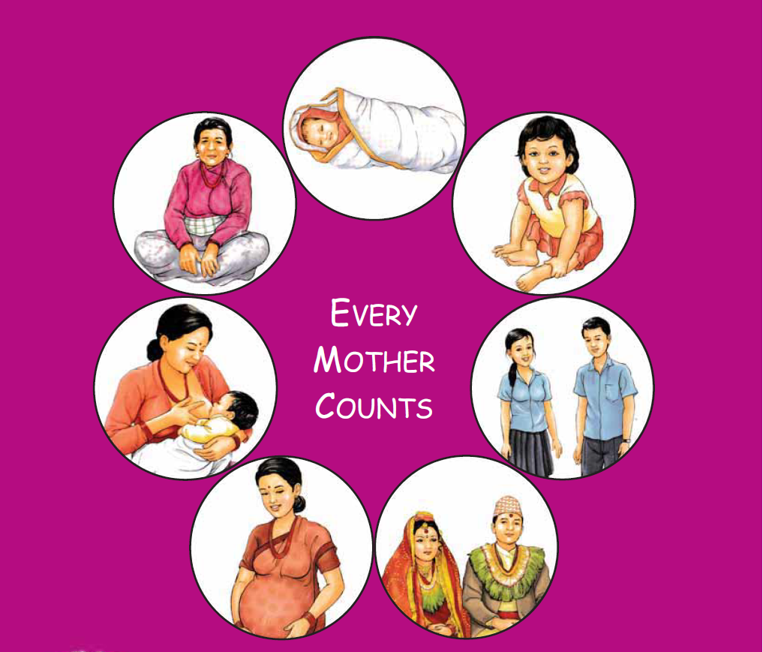
Maternal and Perinatal Death Surveillance and Response [MPDSR] - Response Mechanism and Identifying Action Plans-
Every Mother and Child Counts
Every Mother and Child Counts
नेपाल सरकार
स्वास्थ्य तथा जनसंख्या मंत्रालय
स्वास्थ्य सेवा विभाग
परिवार कल्याण महाशाखा
Notes:
Inform that there will be separate session where the participants will be provide with detailed information on tools used in hospital.
©: Tools used for review and response to community maternal deaths
(H): Tools used for review and response to hospital maternal and perinatal deaths

Slide 2
Objectives
By the end of session, the participants will be able to
formulate evidence based actions and prioritization based on the information from the filled MDR and PDR forms, and
describe how the action plan will be implemented for improving quality of care.

Slide 3
MPDSR: A Continuous Process of Learning
Information
Accountability
Maternal death – who, where, how, when
Actions – Policy, strategies, protocols, guidelines, programme, activities, management/administration etc.
Cause of Death (MDR + VA)
Avoidable factors (HF + Community)
Notification
MPDR at HF
Response
Surveillance
Review
Action Plan
Screening
Verbal Autopsy
☹ Learning ☹ Learning ☹ Learning ☹ Learning ☹ Learning ☹ Learning ☹ Learning ☹ Learning☹
Notes:
It is important to explain that MPDSR is a continuous process of learning. Each case of maternal and perinatal death has different story to tell and different lessons to learn from. Therefore no case on maternal death at the community and hospital and perinatal death at hospital should be missed. Information should be collected and shared as much as possible regarding who, how, when, where, cause of death should be determined accurately and avoidable factors should be identified. This will assist in developing action plans for improving the system.
It is most important to have accountability from local to national level to implement the response mechanism.

Slide 4
Response Mechanism
Taking action to reduce avoidable maternal deaths is the reason for conducting MPDSR
Type of action will depend on the delays or avoidable factors identified during review at hospital level and community level.
Action plans should be based on evidence- based actions
Need to prioritize the actions which are simple, practical/doable, evidence based and cost effective
Link the response to quality of care at the hospital

Slide 5
What are Evidence Based Actions
Actions for which there is enough evidence that maternal mortality and morbidity will be prevented if they are followed
Usually refer to clinical actions, based on trials, researches & standard guideline
Individual cases should be reviewed to see if “best practices” were carried out or not
Review should be targeted on identifying which better evidence based action might have been taken to manage the particular case
Notes:
The WHO Integrated Management of Pregnancy and Childbirth (IMPAC) guidelines can be adapted for this purpose, particularly in resource-poor countries.

Slide 6
Evidence Based Actions for Eclampsia
Diagnosis and treatment of high blood pressure
Magnesium Sulphate
Timely delivery

Slide 7
Evidence Based Actions for Haemorrhage
Active management for 3rd stage labour
Uterotonics (Misoprostol/Oxytocin)
Blood transfusion

Slide 8
Evidence Based Actions for Sepsis
Aseptic precautions
Antibiotics for mother with prolonged rupture of membrane
Antibiotics for C/S
Avoid prolonged labour

Slide 9
Evidenced Based Actions for Obstructed Labour
Facility delivery
Use of Partograph as a decision-making tool
Availability of C/S service

Slide 10
Ensuring Responses Mechanism
Identify avoidable factors and use evidence-based approach to review
Use “Five WHY” method to identify the root cause of the avoidable factor and develop action plan to prevent the avoidable factor. estimate timeline, monitor and timely communication
Monitor to ensure implementation of action plans

Slide 11
Example: Five WHY Review method
MgSO4 not given to patient with eclampsia in ER
Not available at Emergency Room
Store informed
Store locked
Store keeper on leave

Slide 12
Example: Five WHY Review method
MgSO4 not given to patient with eclampsia in ER
MgSO4 available but on duty staff not confident
Protocol not available

Slide 13
Case Scenario
A 20-year old primi gravida with term pregnancy was admitted in hospital in active phase of labour. She had 2 ANC visits in 6 and 8 months at a local HP. She was referred from a birthing center for prolonged labour with no documents.
At the hospital, trial for labour was given for 6 hours and decided for cesarean section. The operation got delayed due to unavailability of blood. However, the operation was performed 2 hours later. A fresh still born baby was delivered. Massive hemorrhage occurred during the operation and the woman could not be saved.

Slide 14
Possible Actions Include
Feedback for timely referral to the referring birthing center
Use of partograph / expert consultation for timely decision making
Coordination with blood banks for timely availability of blood
Increased preparedness for in-referrals and timely out-referrals with life saving arrangements
Review and sharing of findings/ results in periodic meetings
Notes:
Examples of immediate actions at community levels:
Sharing the issues on maternal death in appropriate forums especially at mother’s group meetings.
Quality assurance of ANC/ Natal/ Postnatal care including lab investigations.
Utilization of funds (for example FCHV fund, EOC fund, Referral fund and other fund if available) for emergencies.
Strengthening the referral system.
Community awareness on risk factors
Deciding the health facility opening hours and duty adjustments
Ensuring sufficiency of essential drug and other logistics
Infection prevention and compliance to other service standards
Examples of Periodic response at community level:
Review and sharing of findings/ results in FCHV bi-monthly review meeting and raising awareness.
Sharing of information and discussion during Ilaka meetings and preparation of appropriate action plan.
Implementation of the feedback provided by higher authorities.
Strengthening health promotion activities like training, street drama, local cultural programs in local language.
Examples of Annual response at community level:
Sharing the findings and discussion with Nagarik Wada Manch, VDC members and those who can make a difference.
Advocacy and annual planning in VDC council to prevent maternal deaths.
Examples of Immediate response at hospital level:
Sharing the issues on maternal death and perinatal deaths in MPDR committee and hospital staff meetings.
Quality assurance of health care
Utilization of funds available in the hospitals or creation of funds for emergencies.
Increased preparedness for in-referrals and timely out-referrals with life saving arrangements
Staff awareness on risk factors
Health facility opening hours and duty adjustments
Ensuring sufficiency of essential drug and other logistics
Infection prevention and compliance to other service standards
Other specific arrangements and quality of care improvement
Examples of Periodic response at hospital level:
Review and sharing of findings/ results in periodic meetings.
Sharing of information and discussion during stakeholder/partners meetings
Implementation of the feedback provided by DPHO and other government agencies.
Incorporating maternal and perinatal death prevention and curative actions into work plan
Other specific actions
Examples of Annual response at hospital level:
Sharing the findings and discussion with GoN and partners during meetings.
Advocacy to prevent maternal deaths.
Presentation of data, issues and action taken/to be taken in health review meetings
Other innovations
Examples of Immediate response at district level:
Implement recommendations and feedback made by MPDSR committees
Organization and sharing of information in MPDSR and RHCC meetings
Preparation of strategy to prevent the three delays
Coordination with stakeholders for technical and financial/logistic support
Provision of feedback to respective MDSR committees below districts
Support hospital MPDR committees and prompt budget disbursement
Provision of flexible fund in DHO/DPHO
Improved information management including HMIS
Other district specific innovations
Examples of Periodic response at district level:
Sharing the information in different forums like RHCC meeting, review meeting etc.
Monitoring and supervision of Health Facilities/ Birthing Centres
Sharing of information and discussion at Ilaka meetings and making appropriate plans
Implementation of feedback provided by higher authorities
Incorporating maternal and perinatal death prevention action plan in periodic plans
Strengthening health promotion activities like training, street drama, local cultural programs based on local language
Examples of Annual response at district level:
Sharing the information/ issues at district and regional review meetings
Need-based program planning with DDC and other stakeholders
Other district specific innovations
Examples of Actions at Regional level:
Implement recommendations and feedbacks made by MPDSR committees
MPDSR focused monitoring and supervision
Respond, provide feedback/guidance on district reporting
Sharing the issues in regional forums and national reviews
Coordination between districts and centres for programs to reduce maternal deaths
Providing technical support to hospitals and D/PHOs
Incorporating maternal and perinatal death prevention action plan in periodic plans
Examples of actions at Central level
Implementation of recommendations made by MPDSR committees
Review on Policy and program alignment in view of equity and access
Advocacy, acquisition and continuity of resources (Human resources, finance, logistic, institutional development etc.)
National review and response with focus on appropriate innovations and technologies
Coordination with relevant ministries and stakeholders
Incorporating maternal and perinatal death prevention plan in plan documents
Make arrangements to comply with national and global commitments
Make regular contacts with authorities directly or indirectly involved in maternal and child health improvement
Research activities in the subject area and co-ordination with agencies.

Slide 15
Community-based actions
Changing health seeking behavior
Addressing transportation issues
Reducing cost of accessing care
Identification and prompt referral
Raise awareness on safe motherhood programs
Mobilize “AAMA Samuha” to raise awareness and implement preventive programs

Slide 16
The actions are likely to be successful if they are innovative, focused to avoid preventable factors and involve all stakeholders for participation.

Slide 17
Prioritizing Actions
When there are many options, how do you pick from among them?
Not all problems can be tackled simultaneously
Prevalence – how common is the problem?
Feasibility of carrying out the action
Are there extra staff available? Is it technologically and financially possible?
What is the potential impact of the action?
If successfully implemented how many women would be reached and how many lives saved?

Slide 18
Example of Avoidable Factors
PATIENT ASSOCIATED
Never initiated antenatal care
Infrequent visits to antenatal clinic
Inappropriate response to rupture of membranes
Inappropriate response to antepartum haemorrhage
Inappropriate response to poor fetal movements
Delay in seeking medical attention during labour
Attempted termination of pregnancy
Failed to return on prescribed date
Declines admission/treatment for personal/social reasons
Partner/Family decline admission/treatment

Slide 19
Example of Avoidable Factors
ADMINISTRATIVE PROBLEMS
Lack of transport – Home to institution , institution to institution
Insufficient blood/blood products available
Personnel not sufficiently trained to manage the patient
Personnel too junior to manage the patient
No dedicated high risk ANC at referral hospital
Insufficient nurses on duty to manage the patient adequately
Insufficient doctors available to manage the patient
Anaesthetic delay
No accessible neonatal ICU bed with ventilator
Staff rotation
Lack of adequate neonatal transport

Slide 20
Example of Avoidable Factors
MEDICAL PERSONNEL ASSOCIATED
Medical personnel underestimated fetal size
No response to history of stillbirths, abruption, etc.
No response to poor uterine fundal growth
No response to maternal hypertension
No antenatal response to abnormal fetal lie
Poor progress in labour, but partograph not used,
Partograph not used correctly, partograph interpreted incorrectly
Fetal distress not detected intrapartum
Management of 2nd stage: prolonged with no intervention
Breech presentation not diagnosed until late in labour

Slide 21
Example of Avoidable Factors
MEDICAL PERSONNEL ASSOCIATED
Delay in medical personnel calling for expert assistance
Delay in referring patient for secondary/tertiary treatment
No response to apparent post-term pregnancy
Neonatal care: inadequate monitoring
Neonatal care: management plan inadequate
Baby sent home inappropriately
No response to history of poor fetal movement
Multiple pregnancy not diagnosed intrapartum
Physical examination of patient at clinic inappropriate
Delay in doctor responding to call

Slide 22
Example of Avoidable Factors
MEDICAL PERSONNEL ASSOCIATED
Nosocomial infection
Inadequate/no advice given to mother
Antenatal steroids not given
Incorrect management of antepartum haemorrhage
Incorrect management of premature labour
Incorrect management of cord prolapse
INSUFFICIENT NOTES TO COMMENT ON AVOIDABLE FACTORS
Insufficient notes
File missing
Antenatal card lost

Slide 23
Implementation of Action Plan
Recommendations made by the different levels MPDSR committees should be carried out at each level of health care provision. This will ultimately lead to actions, which in turn will be responsible for improvement in patient care as well as improvement in health care at the community.
The response at different level may be diverse due to authority, resources, capacity of the committees, socio-economic conditions of the community and population coverage.

Slide 24
Implementation of Action Plan
Action plans developed after reviewing of each maternal death should be finalized and shared with the concerned authorities within 1 week.
Responsible authority
Supportive authority
Reporting to be done in web-based system immediately for maternal death and monthly for perinatal death. Monitoring will be done by:
PHD
HO
FWD

Slide 25
Implementation of Action Plan
Responsible authority needs to coordinate and initiate the process of the action plan.
Any support needed for implementation of the action plan should be timely communicated.
The status of the action plan should be discussed monthly.
Challenges while implementing action plans should be documented and communicated.
Reporting should also include completed action plans.

Slide 26
Cause of maternal deaths

Slide 27
Cause of maternal deaths

Slide 28
 | January | February | March | April | May | June
A. Total number of deliveries (including stillbirths) | 713 | 644 | 589 | 630 | 558 | 540
B. Total number of maternal deaths | 15 | 16 | 16 | 14 | 13 | 10
C. Deaths due to PPH | 8 | 5 | 4 | 7 | 5 | 4
D. Deaths to PE/E | 5 | 8 | 5 | 5 | 4 | 2
E. Deaths due to pregnancy-related infection | 2 | 3 | 7 | 2 | 4 | 4
H. Proportion of deaths due to PPH (Row C divided by Row B)
I. Proportion of deaths due to PE/E (Row D divided by Row B)
J. Proportion of deaths due to infection (Row E divided by Row B)

Slide 29
 | January | February | March | April | May | June
A. Total number of deliveries (including stillbirths) | 713 | 644 | 589 | 630 | 558 | 540
B. Total number of maternal deaths | 15 | 16 | 16 | 14 | 13 | 10
C. Deaths due to PPH | 8 | 5 | 4 | 7 | 5 | 4
D. Deaths to PE/E | 5 | 8 | 5 | 5 | 4 | 2
E. Deaths due to pregnancy-related infection | 2 | 3 | 7 | 2 | 4 | 4
H. Proportion of deaths due to PPH (Row C divided by Row B) | 53% | 31% | 25% | 50% | 38% | 40%
I. Proportion of deaths due to PE/E (Row D divided by Row B) | 33% | 50% | 31% | 36% | 31% | 20%
J. Proportion of deaths due to infection (Row E divided by Row B) | 13% | 19% | 44% | 14% | 31% | 40%

Slide 30
 | January to June
A. Total number of deliveries (including stillbirths) | 3674
B. Total number of maternal deaths | 84
C. Deaths due to PPH | 33
D. Deaths to PE/E | 29
E. Deaths due to pregnancy-related infection | 22
H. Proportion of deaths due to PPH (Row C divided by Row B) | 39%
I. Proportion of deaths due to PE/E (Row D divided by Row B) | 35%
J. Proportion of deaths due to infection (Row E divided by Row B) | 26%

Slide 31
First leading cause of death: PPH
Second leading cause of death: Pre/eclampsia

Slide 32
Actions
 | Modifiable factors | Actions
1 | No uterotonic for prevention and management of PPH in the labour ward Provider did not know how to manage PPH | Ensure availability of oxytocin in the labour ward 24/7 Develop a log to track availability of oxytocin Ensure that providers know how to manage uterine atony and other causes of PPH
2 | Immediate postpartum prophylactic uterotonic not administered (active management of the third stage of labour) Woman not monitored for bleeding after delivery | Ensure that all providers are competent and understand the importance of providing active management of the third stage of labour Introduce a systematic written protocol, with assigned staff, to monitor all women for bleeding and other danger signs after birth

Slide 33
Actions
 | Modifiable factors | Actions
3 | Delayed identification of PPH in the postnatal ward No uterotonic available in the postnatal ward | Ensure that providers conduct regular postnatal checks in the postnatal ward Ensure that providers document regular postnatal checks in the client file Ensure availability of oxytocin in the postnatal ward 24/7 Develop a log to track availability of oxytocin
4 | Provider did not know how to manage PPH Lack of blood and/or blood products | Strengthen providers’ skills to manage atonic uterus and other causes of PPH Ensure the existence of a log/system to monitor and document availability of blood and blood products Introduce team-based PPH simulation drills to strengthen coordination and performance of all relevant staff in an emergency.

Slide 34
Prioritising Response
What are the most common modifiable factors contributing to PPH that your team should prioritise?
Based on these common modifiable factors and the recommended responses, discuss how your committee will prioritise aggregate responses to accelerate the reduction of deaths of women due to PPH in your facility.

Slide 35
नेपाल सरकार
स्वास्थ्य तथा जनसंख्या मंत्रालय
स्वास्थ्य सेवा विभाग
परिवार कल्याण महाशाखा
Every Mother and Child Counts

