Slide 1
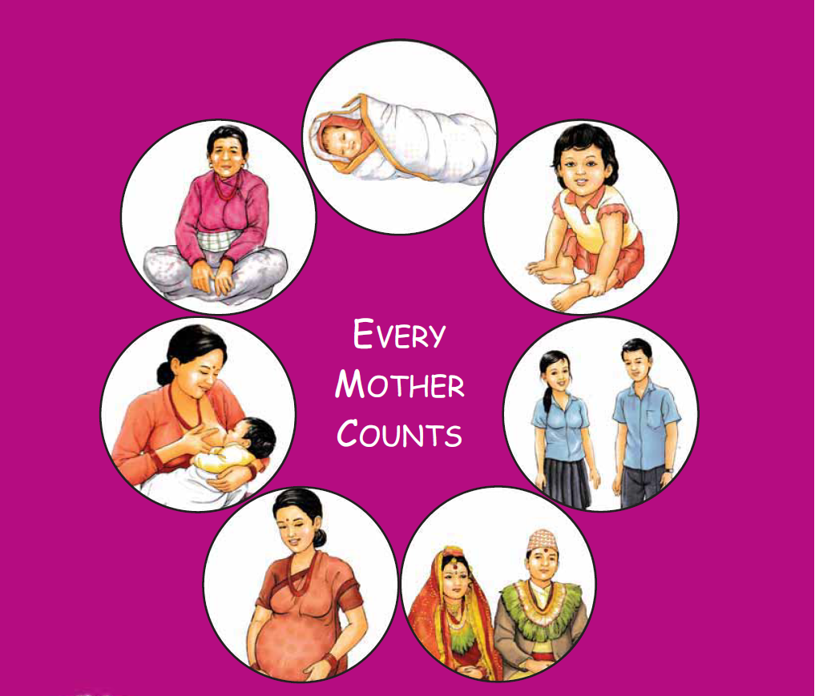
Maternal and Perinatal Death Surveillance and Response [MPDSR] - Determinants of Maternal Death -
Every Mother and Child Counts
Every Mother and Child Counts
नेपाल सरकार
स्वास्थ्य तथा जनसंख्या मंत्रालय
स्वास्थ्य सेवा विभाग
परिवार कल्याण महाशाखा
Notes:
Inform that there will be separate session where the participants will be provide with detailed information on tools used in hospital.
©: Tools used for review and response to community maternal deaths
(H): Tools used for review and response to hospital maternal and perinatal deaths

Slide 2
Objectives
By the end of session, the participants will be able to
identify the determinants of maternal death,
differentiate between causes and determinants of maternal death and
classify determinants using “Three Delays” model.

Slide 3
Causes and Determinants of Maternal Death
Causes
The immediate clinical or medical reason for the woman’s death, classified as a direct or indirect maternal death
Determinants
The “Causes of the Causes” or factors that increased the woman’s risk of dying from specific cause

Slide 4
Possible Determinants
Possible causes of death | Determinants/Contributing social factors
Hemorrhage | Poor nutritional status
Ruptured uterus/Obstructed labor | Insufficient access to family planning; Too many closely spaced pregnancies; early marriage
Sepsis | Lack of clean delivery; Lack of clean water in health facilities; Unwanted pregnancy (followed by induced abortion)

Slide 5
Common Determinants of Maternal Deaths
Poor access to family planning and safe abortion
Insufficient use of antenatal services
No skilled attendance at delivery
Difficulties in obtaining transport
Insufficient supplies or staff
Low status of women
These are very different factors, operating at different levels of social influence

Slide 6
The “3 Delays” Model
Generally refers to events that are associated with obstetric emergency
Related to seeking and obtaining clinical care
Divides the process of accessing care into 3 phases:
Recognizing an emergency & need for treatment
Reaching a health facility where care is available
Receiving the care that is needed

Slide 7
The Three Delays Model
Delay 1:
Recognition and decision to seek care
Delay 2:
Transport to care
Delay 3: Receiving quality care
Delays 1 & 2 can lead to a women never reaching a facility or arriving in critical condition. Delays within a facility also contribute to maternal deaths
Length of time from onset of a complication to decision to seek care
Once decision to seek care is made, there can be delays in reaching it

Slide 8
Strategies to reducing these 3 delays
Notes:
For provision of care: need infrastructure, trained HR, equipment and medicines,
For quality of care: Audit, Trainings and drills, M & Supervision

Slide 9
Delay 1
Delay in deciding to seek care:
Rapid recognition of a problem can be critical for saving a mother’s life (esp. for excessive bleeding)
Delay 1 measured as length of time from onset of a complication to decision to seek care.
Causes for delay in deciding to seek care:
Education, socio-economic status and women’s autonomy also affect in seeking care
Determinants include:
Inadequate knowledge
Reliance on family members who are not present
Lack of familiarity with or trust in services
Costs related to accompanying woman or paying fees/ expenses related to services

Slide 10
Delay 2
Delay in reaching care:
Once decision to seek care is made, there can be delays in reaching it
Determinants include:
Unavailable or affordable transport
Long distances to facilities
Inadequate referral systems between facilities
High cost of transportation.
Inequitable or insufficient distribution of BEOC/CEOC services increase type 2 delays

Slide 11
Delay 3
Delay in receiving care:
Delays 1 & 2 can lead to a woman never reaching a facility or arriving in critical condition
Delays within a facility also contribute to maternal deaths or “near misses”
Determinants include:
Shortages of staff, equipment or blood products
Time lag between arrival and initiation of treatment/surgery
Poor technical competence

Slide 12
Addressing Community Level Determinants
Delay 1 relates mainly to individual and family determinants
Delay 2 relates to Community determinants
Delay 3 relates to Health System determinants
All delays reflect background factors, such as:
Women’s autonomy & education
Availability and accessibility of reproductive health services
Quality of care at health facilities

Slide 13
Example of Delay, Contributing Factors & Corresponding Response to Address
Delay | Contributory Factors | Strategies to Address
Delay in seeking care | Poor awareness Insufficient fund No trust in facility | Awareness on emergency sign Community transportation scheme Awareness of quality improvement Adaptation to cultural preference
Delay in reaching care | Distance to reach facility Poor referral system Inability to pay fee | Birth preparedness (moving client close to facility at time of birth) Assign staff to link between facility Social security scheme

Slide 14
Example of Delay, Contributing Factors & Corresponding Response to Address
Delay | Contributory Factors | Strategies to Address
Delay in obtaining care | No staff on duty in weekend Inadequate supply Poor follow-up (after delivery) | Improve staff availability Improve logistic supply system Establish recovery room & monitoring Timely referral
Notes:
Some of the evidence based actions are also provided after the slides for more explanation and discussion.

Slide 15
Group Work
List 5 leading causes of maternal deaths
Divide in to 3 groups
Select primary cause of maternal death for each group based on your earlier group work
Identify the determinants of maternal deaths based on given cause.
Group the determinants into health related and non-health related determinants
Classify the determinants in “Three Delays” model

Slide 16
Presentation Template
Describe the case:
Write primary Cause of Maternal Death:
Possible Determinants: Jot down all possible determinants
Categorize the determinants in three delay model
Delay1 Related Determinants:
Delay2 Related Determinants:
Delay3 Related Determinants

Slide 17
Summary Points
Social determinants are the “causes of the causes” of maternal deaths, and depend on many social levels
Addressing maternal deaths thus requires action at every level, not just medical or health services
Because many women die at home, in transit or soon after arrival at a facility, understanding the delays in receiving care helps analyze patterns of deaths
MPDSR identifies determinants related to the 3-Delays from the onset of obstetric complications
At higher levels (national, regional), social determinants beyond 3-delays should be considered (culture, gender)

Slide 18
नेपाल सरकार
स्वास्थ्य तथा जनसंख्या मंत्रालय
स्वास्थ्य सेवा विभाग
परिवार कल्याण महाशाखा
Every Mother and Child Counts

