Slide 1
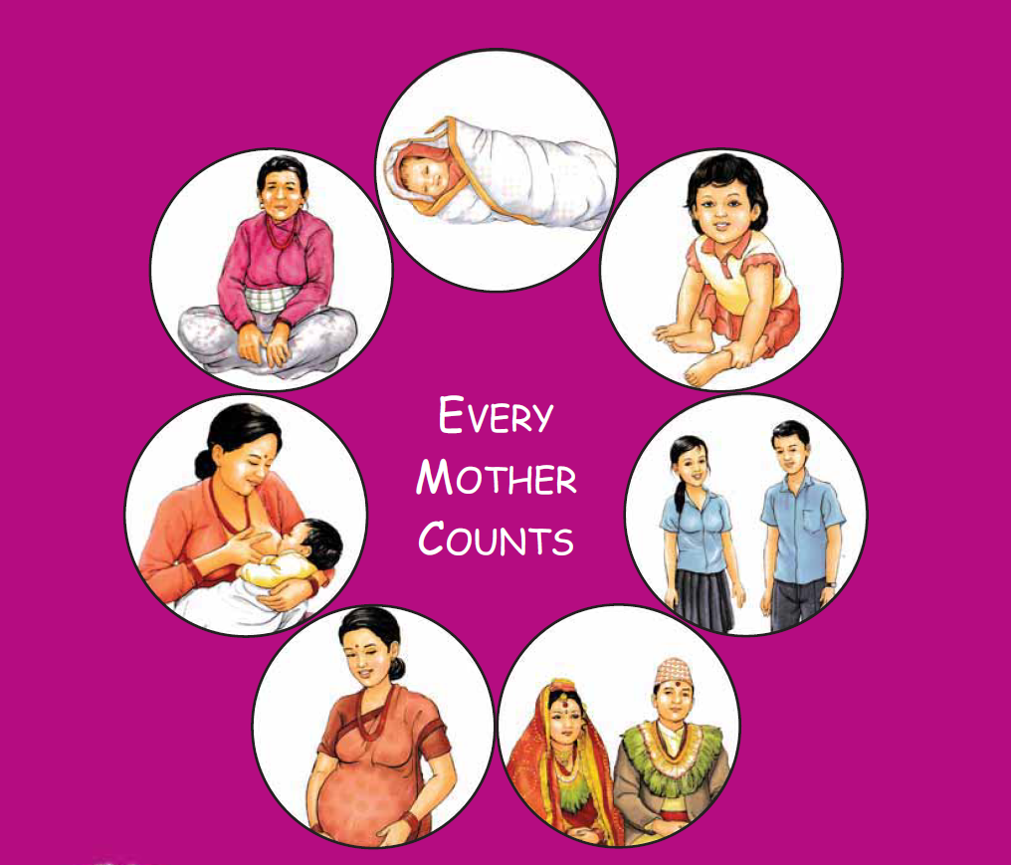
Maternal and Perinatal Death Surveillance and Response [MPDSR] - MPDSR Tools -
Every Mother and Child Counts
Every Mother and Child Counts
नेपाल सरकार
स्वास्थ्य तथा जनसंख्या मंत्रालय
स्वास्थ्य सेवा विभाग
परिवार कल्याण महाशाखा
Notes:
Inform that there will be separate session where the participants will be provide with detailed information on tools used in hospital.
©: Tools used for review and response to community maternal deaths
(H): Tools used for review and response to hospital maternal and perinatal deaths

Slide 2
Tools Used in MPDSR
Maternal Deaths:
A. Community Deaths:
i. Notification Form
ii. Screening Form
iii. Verbal Autopsy Form (including cause of death assignment form)
B. Hospital Deaths:
i. Maternal Death Review Form (MDR)
Perinatal Deaths (Only hospital deaths):
Perinatal Death Review Form (PDR)
PDR Summary Form

Slide 3
MDR Form for Hospital Deaths

Slide 4
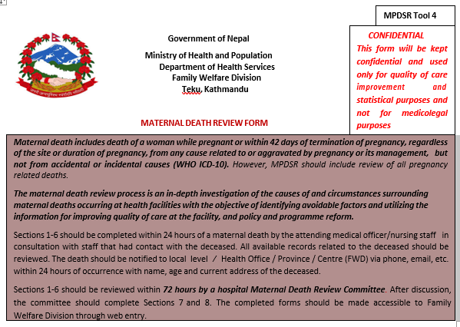
Notes:
MDR form is to be filled for maternal deaths within health facilities/hospitals

Slide 5
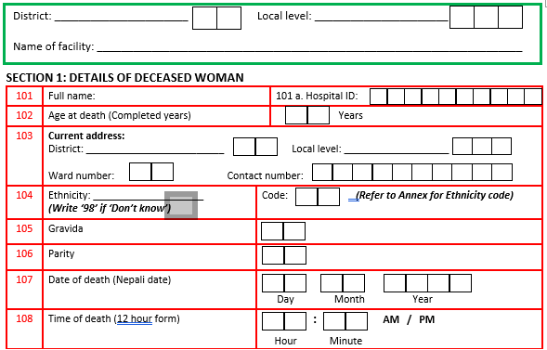

Slide 6
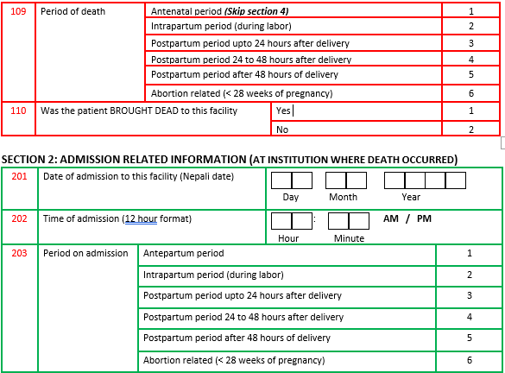

Slide 7
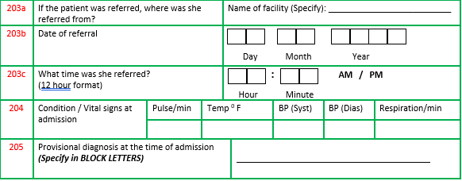

Slide 8
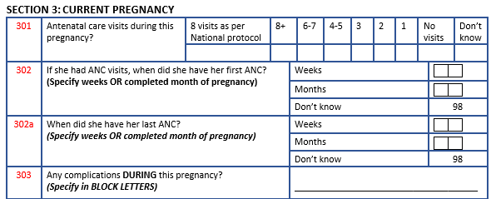

Slide 9
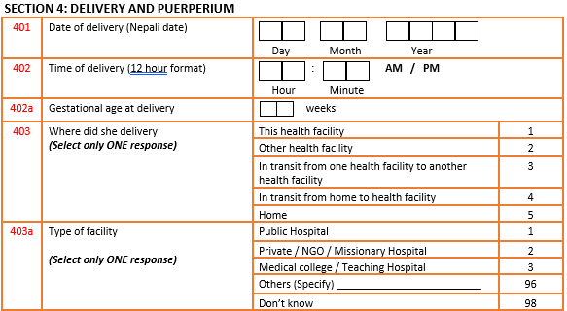

Slide 10
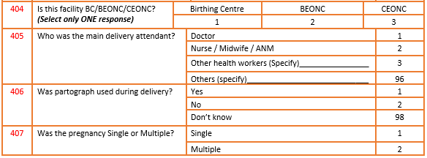

Slide 11
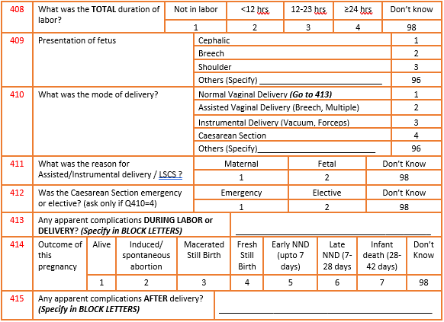

Slide 12
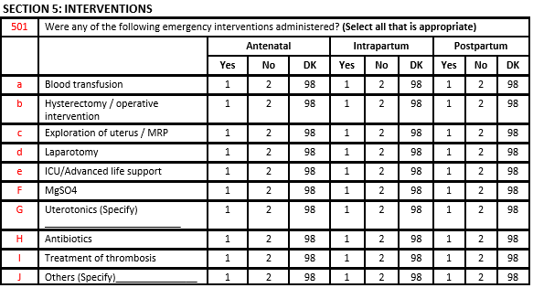

Slide 13
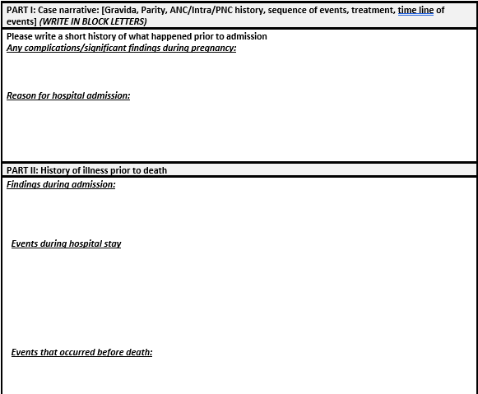

Slide 15
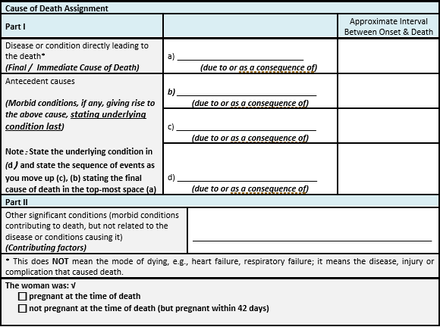

Slide 16
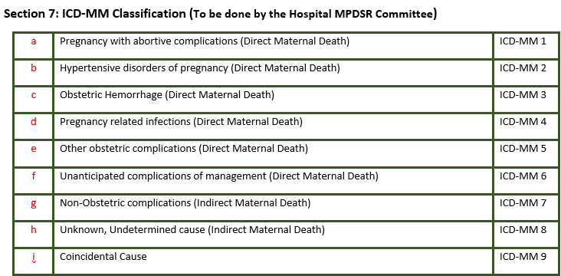

Slide 17
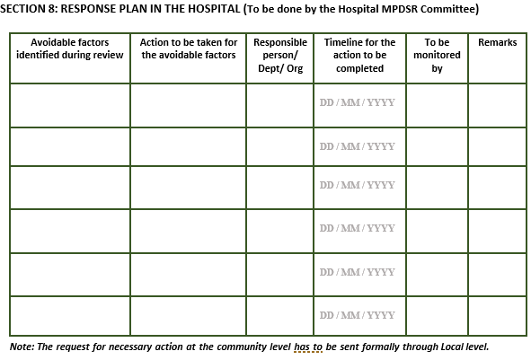

Slide 18
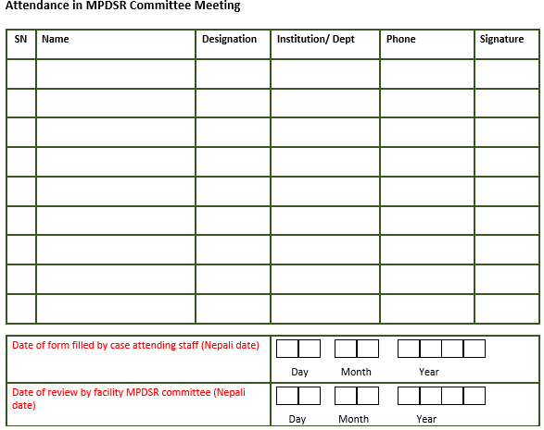

Slide 19
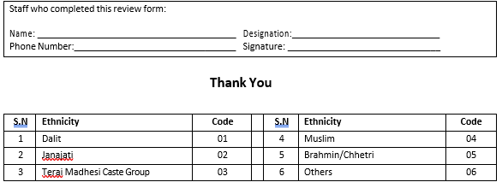

Slide 20
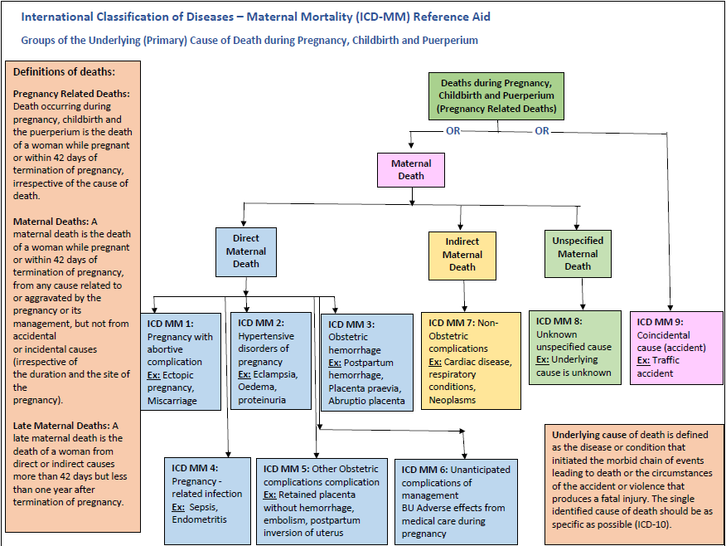

Slide 21
PDR Form for Hospital Deaths

Slide 23
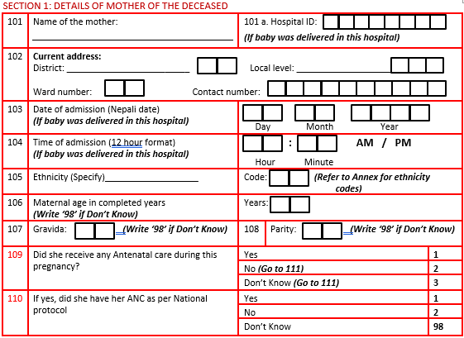

Slide 24
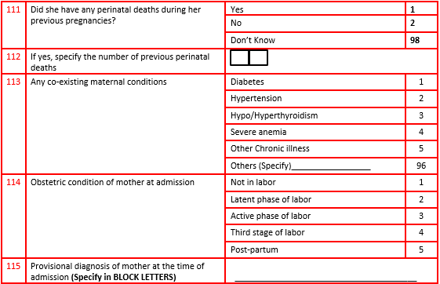

Slide 25
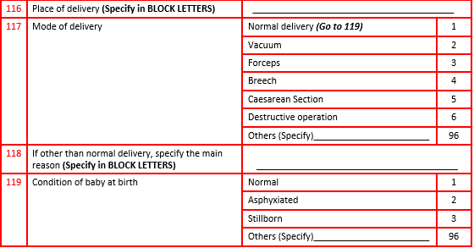

Slide 26
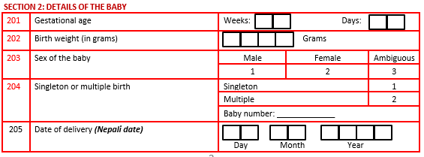

Slide 27
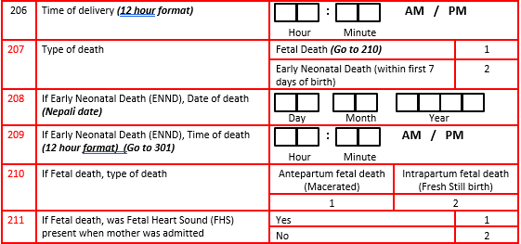

Slide 28
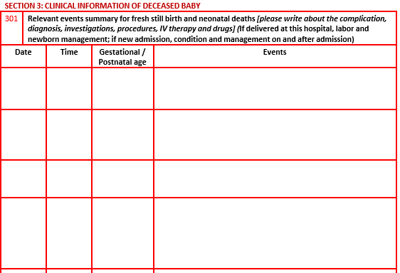

Slide 29
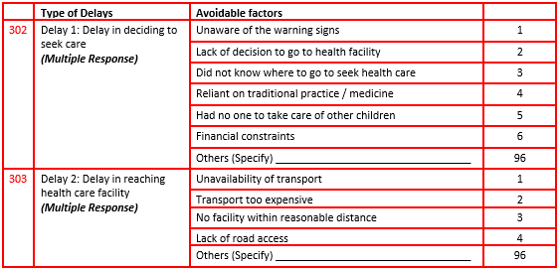

Slide 30
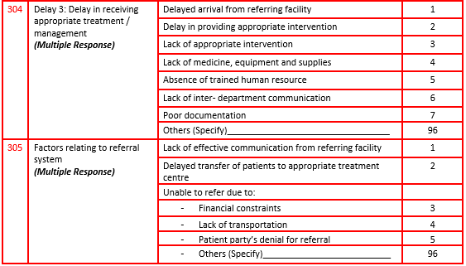

Slide 31
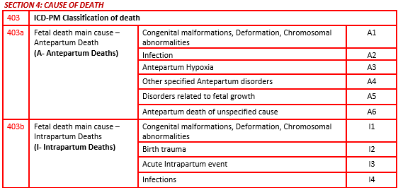

Slide 32
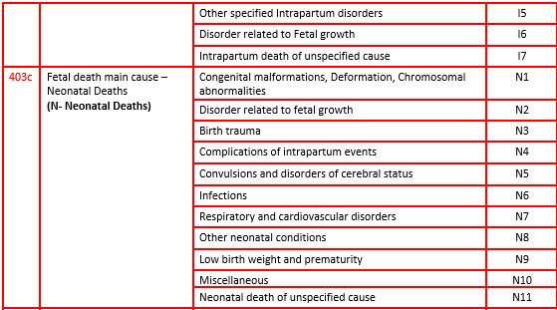

Slide 33
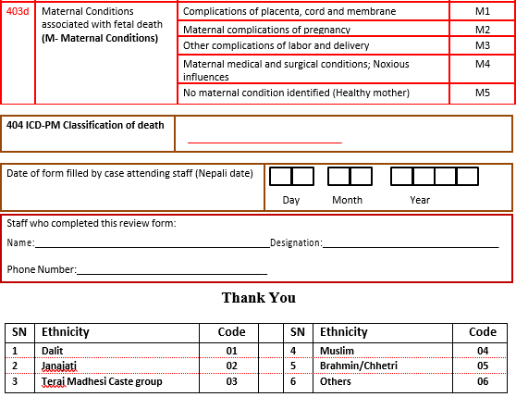

Slide 35
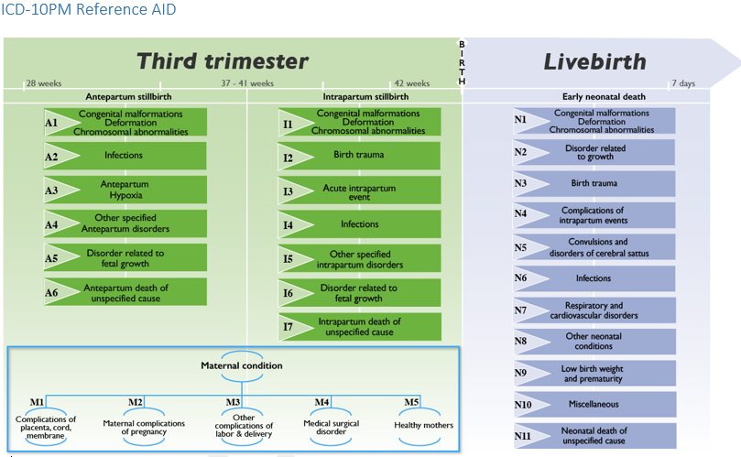

Slide 36
PDR Summary Form for Hospital Deaths
Notes:
The summary form is to be prepared once a month for all the perinatal deaths within the hospital during that month and presented to the hospital MPDSR Committee for monthly review meeting

Slide 38
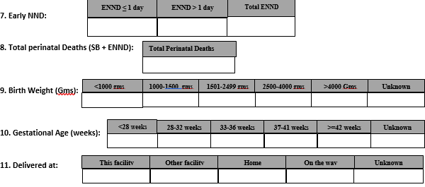

Slide 39
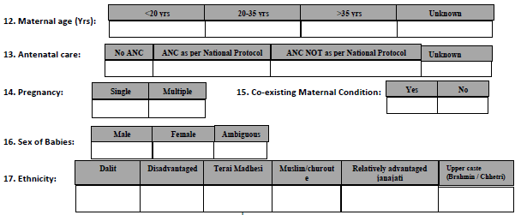

Slide 40
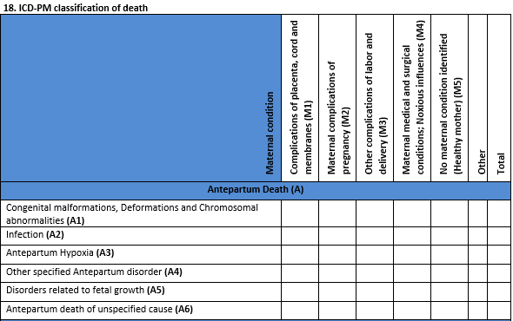

Slide 41
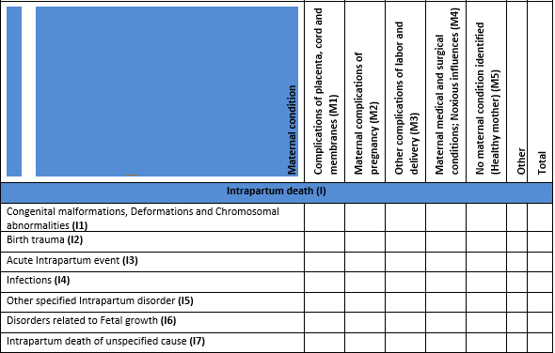

Slide 42
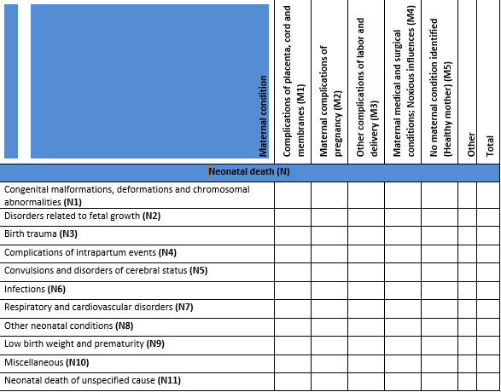

Slide 43
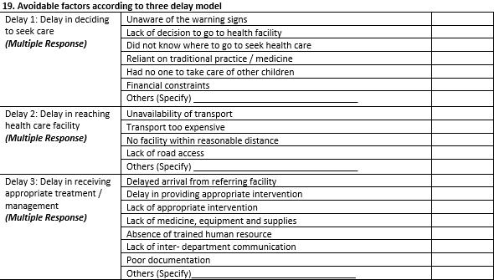

Slide 44
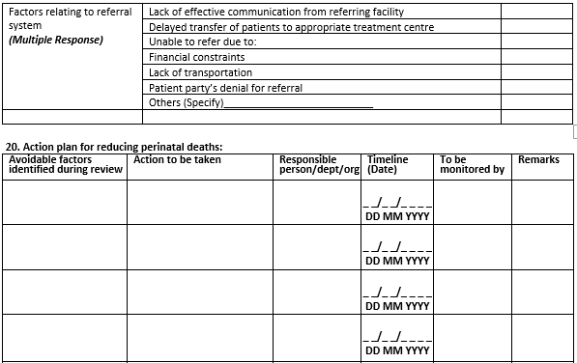

Slide 45
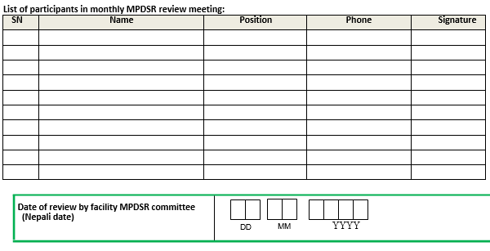

Slide 46
General Instructions to complete the forms

Slide 47
General Instructions to complete the forms
MDR forms must be completed within 24 hrs of occurrence of maternal death.
MPDSR review must be conducted within 72 hrs of occurrence of maternal death.
Choose only ONE answer unless multiple answers are indicated.
Use Nepali (Bikram Sambat) dates while filling the date column.
Date: Please note the day in two dd boxes, note the month in the mm boxes and the year in the yyyy boxes.
Eg:
Day |  | Month |  | Year
0 | 2 | 0 | 5 | 2 | 0 | 7 | 7

Slide 48
General Instructions Contd…
The time should be completed in 12 hour format, and select whether it is AM / PM. If the digit is single then “0” should be filled in the first box and the single digit in the next box. For example: if time is 04:15 AM then the box should be filled as:
AM / PM
Check the correct option by circling the number clearly. In case of need of correction, the mistake should be clearly cut with double line and the right option should be circled.
Eg:
Use block letters for writing any information.
Hours |  | Minutes
0 | 4 | 1 | 5

Slide 49
नेपाल सरकार
स्वास्थ्य तथा जनसंख्या मंत्रालय
स्वास्थ्य सेवा विभाग
परिवार कल्याण महाशाखा
Every Mother and Child Counts

