Slide 1
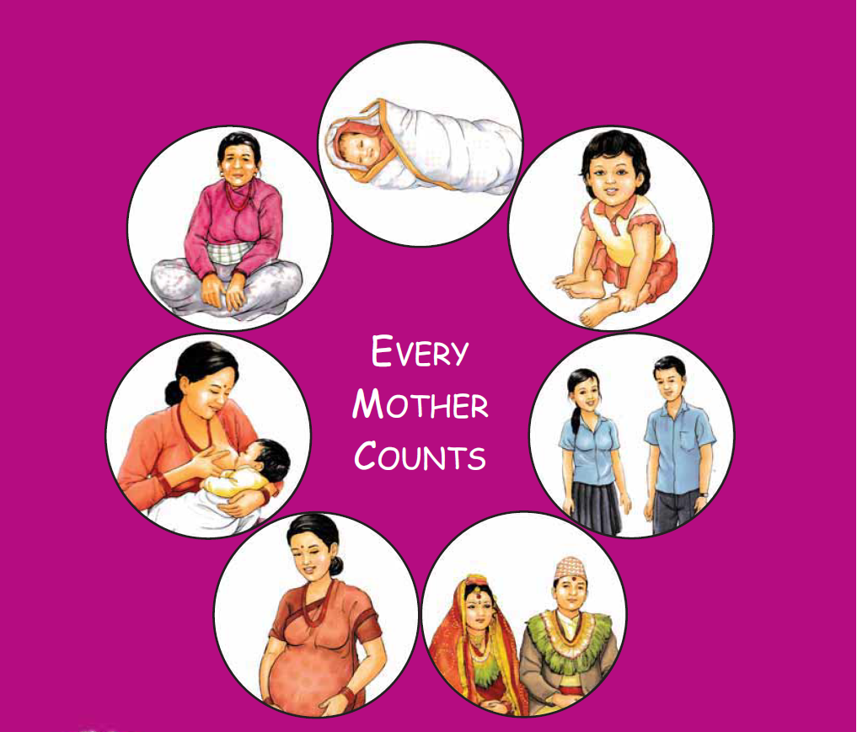
Maternal and Perinatal Death Surveillance and Response [MPDSR] - Cause of Death –
ICD-MM
Every Mother and Child Counts
Every Mother and Child Counts
नेपाल सरकार
स्वास्थ्य तथा जनसंख्या मंत्रालय
स्वास्थ्य सेवा विभाग
परिवार कल्याण महाशाखा

Slide 2
Objective
By the end of session, the participants will be able to
List the primary, contributory and final causes of death.
Classify maternal deaths according to ICD-MM classification
Classify perinatal deaths according to ICD-PM classification

Slide 3
Cause of Death
All those diseases, morbid conditions or injuries which either resulted in or contributed to death and the circumstances of the accident or violence which produced any such injuries.
(Twentieth World Health Assembly, 1967)
Does not include signs and symptoms or the mode of dying such as respiratory failure, cardiopulmonary arrest, fever, brain death etc.

Slide 4
Why CoD is important
Social purposes:
Statistical purposes:
Guide resource allocation
Disease trends
National data base

Slide 5
Pregnancy Related Deaths
Pregnancy Related Death
( 12-55 yrs)
Maternal Death
Coincidental (Accidental / Incidental) Death
( ICD-MM 9)
Direct Maternal Death
(ICD-MM 1 to 6)
Indirect Maternal Death
(ICD-MM 7)
Unspecified Maternal Death
(ICD-MM 8)
Notes:
5

Slide 6
Groups of underlying causes of death during pregnancy, childbirth and the puerperium (ICD MM)
Type of death | Group name/number | EXAMPLES of potential causes of death
Maternal death: direct | ICD-MM 1. Pregnancies with abortive outcome | Abortion, miscarriage, ectopic pregnancy and other conditions leading to maternal death and pregnancy with abortive outcome
Maternal death: direct | ICD-MM 2. Hypertensive disorders in pregnancy, childbirth, and the puerperium | Oedema, proteinuria and hypertensive disorders in pregnancy, childbirth and the puerperium
Maternal death: direct | ICD-MM 3. Obstetric haemorrhage | Obstetric diseases or conditions directly associated with haemorrhage
6

Slide 7
Type of death | Group name/number | EXAMPLES of potential causes of death
Maternal death: direct | ICD-MM 4. Pregnancy-related infection | Pregnancy-related, infection-based diseases or conditions
Maternal death: direct | ICD-MM 5. Other obstetric complications | All other direct obstetric conditions not included in groups to 1–4
Maternal death: direct | ICD-MM 6. Unanticipated complications of management | Severe adverse effects and other unanticipated complications of medical and surgical care during pregnancy, childbirth or the puerperium
7

Slide 8
Type of death | Group name/number | EXAMPLES of potential causes of death
Maternal death: indirect | ICD-MM 7. Non-obstetric complications | Non-obstetric conditions • Cardiac disease (including pre-existing hypertension) • Endocrine conditions • Gastrointestinal tract conditions • Central nervous system conditions • Respiratory conditions • Genitourinary conditions • Autoimmune disorders • Skeletal diseases • Psychiatric disorders • Neoplasms • Infections that are not a direct result of pregnancy
8

Slide 9
Type of death | Group name/number | EXAMPLES of potential causes of death
Maternal death: unspecified | ICD-MM 8. Unknown / undetermined | Maternal death during pregnancy, childbirth and the puerperium where the underlying cause is unknown or was not determined
Death during pregnancy, childbirth and the puerperium | ICD-MM 9. Coincidental causes | Death during pregnancy, childbirth and the puerperium due to external causes like accidents, homicide, etc
9

Slide 10
Categories of causes of death
Underlying / Primary cause of death:
The disease or injury which initiated the train of events leading directly to death
The circumstances of the accident or violence which produced the fatal injury
Antecedent cause of death
Condition(s) that led to or precipitated the immediate cause of death
All events/diseases between the immediate cause of death and the underlying cause of death
Immediate/Final cause of death:
The terminal event/disease or complications resulting from underlying cause that led to death
Contributory cause of death:
Diseases that are independent of the causal chain of events/diseases leading to death

Slide 11
Immediate / Final Cause (Only ONE)
Antecedent cause (Can be MORE than one)
Underlying cause (Only ONE)
Contributory causes (Can be MORE than one)

Slide 12
The certifier has to provide a clear sequence of events leading to death
The underlying cause of death …….leading to
The antecedent or intermediary cause(s) of death …….. which leads to
The immediate cause of death

Slide 13
An example of causal chain of diseases
Massive Upper Gastro- intestinal haemorrhage leading to shock
Caused by
Bleeding oesophageal varices
Caused by
Cirrhosis of liver
Caused by
Chronic Hepatitis
Also had
Diabetes
Notes:
Primary / Underlying Cause of Death: Chronic hepatitis
Antecedent Cause of Death: Cirrhosis of Liver
Antecedent Cause of Death: Bleeding Oesophageal varices
Final cause of Death: Massive upper GI haemorrhage
Contributory Cause of Death: Diabetes

Slide 14
An example of causal chain of events/diseases leading to maternal death
Hypovolemic shock
Antepartum haemorrhage
Caused by
Abruptio placenta
Caused by
Pre-eclampsia
Also had
Diabetes
Notes:
Primary / Underlying Cause of Death: Pre-eclampsia
Antecedent Cause of Death: Abruptio Placenta, APH
Final cause of Death: Shock
Contributory Cause of Death: Diabetes

Slide 15
Case: example
25 years old female, 4th para, had a full term normal delivery at home. On 5th day of puerperium she started high grade fever. Fever was neglected for 3 days. On 8th day of puerperium patient was shifted to the hospital. O/E patient was febrile, had foul smelling vaginal discharge. Uterus was not involuted and had tenderness over both fornices. On investigations patient found severely anemic (Hb - 4.5gm%). Patient was treated vigorously. On the same day patient had oliguria, hypotension and had acute renal failure due to puerperal sepsis. Patient died on 9th day of puerperium.

Slide 16
Immediate cause of Death | Acute renal failure
Antecedent cause | Puerperal sepsis
Contributing cause | Anemia

Slide 17
Case: example
26 years old third para, had full termed normal delivery on 1st February 2021 at home. On 5th day she had a high degree fever and severe pain in abdomen. On next day she was shifted to the hospital. O/E doctors noticed that she was in shock and having foul smelling discharge per vagina. Immediately the treatment was started but after 8 hours patient died on 8-02-2021. Relatives gave history that she was treated for severe anemia in second trimester.

Slide 18
Immediate cause: Septicemic shock
(State the disease, injury or complication Due to (or as a consequences of) which caused death, not the mode of dying such as heart failure, respiratory arrest, etc.)
Antecedent cause: Puerperal sepsis
(Morbid conditions, if any, giving rise to Due to (or as a consequences of) the above Cause, stating underlying condition last)
Contributory cause: Anemia
(contributing to the death but not related to the disease)

Slide 19
Formulate a reasonable cause of death statement for a chronic alcoholic man who died after liver cirrhosis and portal hypertension, tremor, hyperammonemia and hepatic encephalopathy which resulted in respiratory arrest and asystole.
Immediate cause of death
Hepatic encephalopathy
Antecedent cause of death
Liver cirrhosis
Underlying cause of death
Chronic alcoholism

Slide 20
Cause of Death Assignment
On duty staff will provide the primary, contributory and final cause of death for hospital Maternal Death which will be finalized by the MPDSR committee at the hospital.

Slide 21
Some TIPS while Assigning Cause of Death
Use common sense and best clinical judgement. There is no substitute.
Read the narrative, history and any other information very carefully.
Corroborate what a health care provider may have said on the form with some other symptom or signs in the checklist.
Do look for important negatives in the history. These can narrow down several possible causes to one or two.
Do not be afraid to state that no cause can be assigned. This is reality.
Write only one cause of death on each line of the death certificate.
Write legibly, and do not use any abbreviations or acronyms
Do NOT make a random diagnosis if none is found.
Do NOT rely on the risk factors alone for making a diagnosis.

Slide 22
How to fill the Medical Certificate of Cause of Death (MCCD) form?

Slide 23
Medical Certificate of Cause of Death (MCCD)
The medical certificate of cause of death (MCCD) is designed to help the certifier record the whole sequence of events leading to death
Death certificates should also include questions about current pregnancy
Should only be recorded by health person
Notes:
WHO 2012, The WHO application of ICD-10 to deaths during pregnancy, childbirth and puerperium: ICD M, World Health Organization 2012

Slide 27
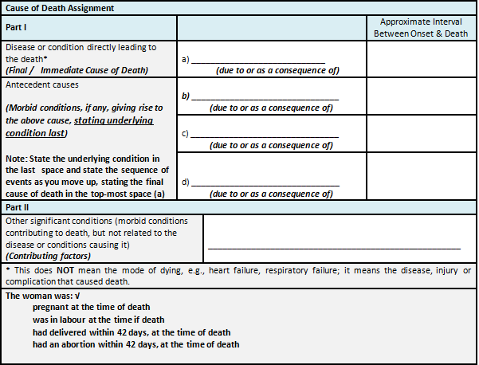

Slide 28
MCCD Example: Abortion
Cause of death (The disease or condition thought to be the underlying cause should appear in the lowest completed line of part I) |  | Approximate interval between onset and death
Part I Disease or condition leading directly to death | a) Septic shock | 5 hours
Antecedent causes: Due to or as a consequence of | b) Septicemia | 24 hours
Due to or as a consequence of | c) Septic incomplete abortion | 72 hours
Due to or as a consequence of | d)
Part II Other significant conditions Contributing to death but not related to the disease or condition causing it
The woman was: X pregnant at the time of death □ not pregnant at the time of death (but pregnant within 42 days) □ pregnant within the past year

Slide 29
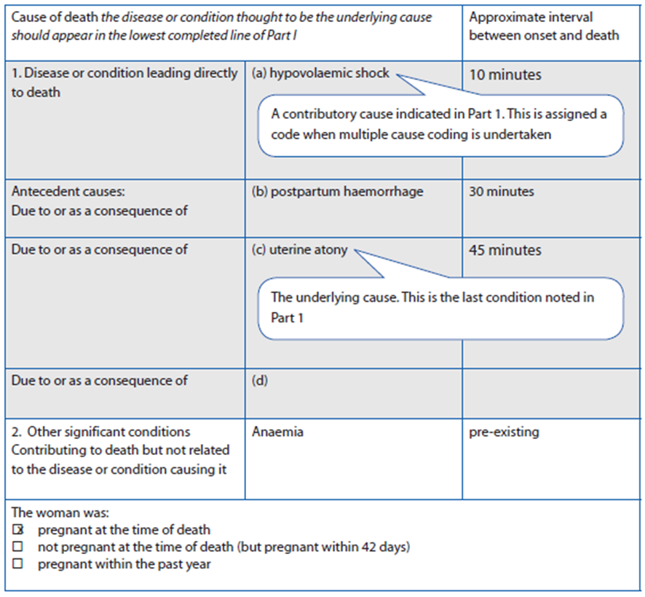
Example 1
A woman who had anemia during pregnancy and after delivery had a postpartum haemorrhage due to uterine atony and died as a result of hypovolemic shock.

Slide 30
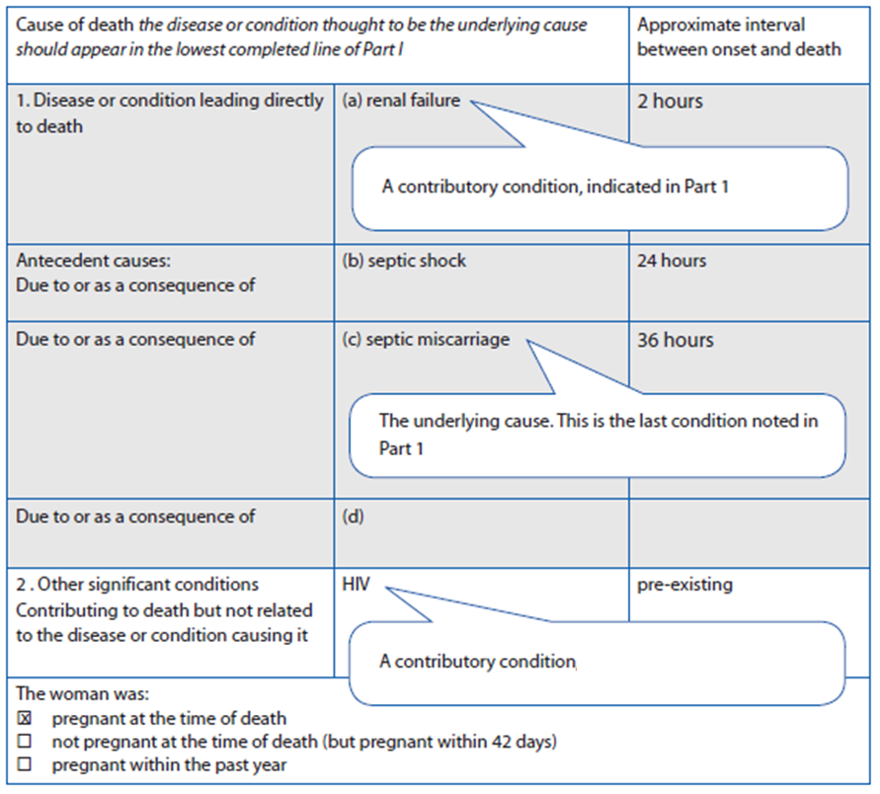
Example 2
A woman infected with HIV who has a spontaneous abortion that becomes infected, and dies due to septic shock and renal failure.

Slide 31
Example of Final Cause of Maternal Death
HYPOVOLAEMIC SHOCK
Hypovolaemic shock following postpartum haemorrhage
Hypovolaemic shock following antepartum haemorrhage
Hypovolaemic shock following ectopic pregnancy
SEPTIC SHOCK
Septic shock following an abortion
Septic shock following a viable pregnancy
Septic shock following an incidental infection

Slide 32
Example of Final Cause of Maternal Death
RESPIRATORY FAILURE (due to)
Adult respiratory distress syndrome
Pneumonia (including Tuberculosis)
Acute respiratory failure
CARDIAC FAILURE (due to)
Pulmonary oedema
Cardiac arrest
RENAL FAILURE (due to)
Acute tubular necrosis
Acute medullary necrosis

Slide 33
Example of Final Cause of Maternal Death
LIVER FAILURE (due to)
Pneumonia (including Tuberculosis)
Liver failure following drug overdose
CEREBRAL COMPLICATIONS (due to)
Intracerebral haemorrhage
Cerebral oedema resulting in coning
Meningitis / infection (including Malaria)
Cerebral emboli
METABOLIC (due to)
Maternal ketoacidosis
Thyroid crisis

Slide 34
Example of Final Cause of Maternal Death
DISSEMINATED INTRAVASCULAR COAGULATION (due to)
Disseminated intravascular coagulation
Liver failure following drug overdose
MULTI-ORGAN FAILURE
Multi-organ failure
IMMUNE SYSTEM FAILURE (due to)
HIV / AIDS
UNKNOWN
Home death
Other

Slide 35
Cause of death assignment
Maternal deaths: ICD- MM classification
Perinatal deaths: ICD-PM classification

Slide 36
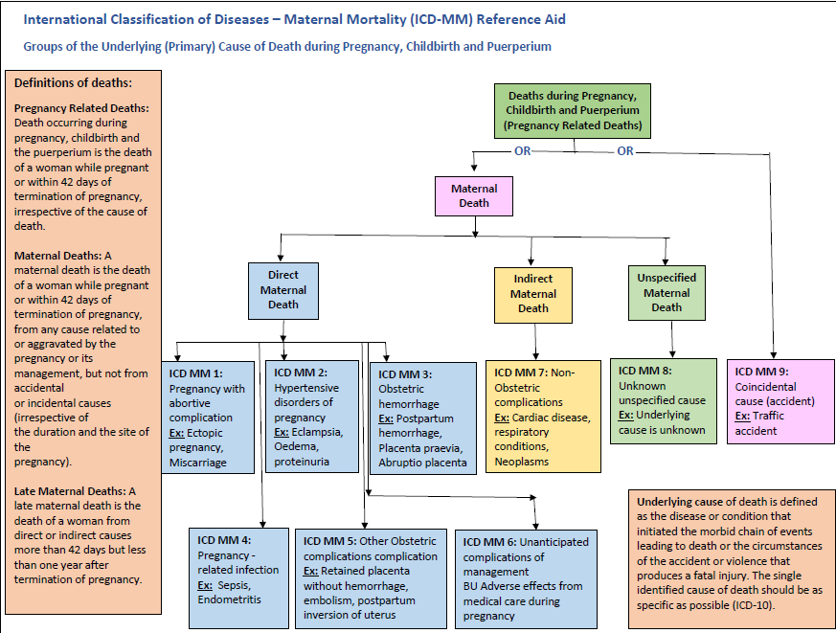

Slide 37
Type | Group name/number | EXAMPLES of potential causes of death
Maternal death: direct | 1. Pregnancies with abortive outcome | Abortion, miscarriage, ectopic pregnancy and other conditions leading to maternal death and a pregnancy with abortive outcome
Maternal death: direct | 2. Hypertensive disorders in pregnancy, childbirth, and the puerperium | Hypertensive disorders of pregnancy, childbirth and puerperium including preeclampsia, eclampsia and gestational hypertension⁸
Maternal death: direct | 3. Obstetric hemorrhage | Obstetric diseases or conditions directly associated with hemorrhage
Maternal death: direct | 4. Pregnancy-related infection | Pregnancy-related, infection-based diseases or conditions
Maternal death: direct | 5. Other obstetric complications | All other direct obstetric conditions not included in groups to 1–4
Maternal death: direct | 6. Unanticipated complications of management | Severe adverse effects and other unanticipated complications of medical and surgical care during pregnancy, childbirth or the puerperium
Maternal death: indirect | 7. Non-obstetric complications | Non-obstetric conditions Cardiac disease (including pre-existing hyper- tension) Endocrine conditions Gastrointestinal tract conditions Central nervous system conditions Respiratory conditions Genitourinary conditions Autoimmune disorders Skeletal diseases Psychiatric disorders Neoplasms Infections that are not a direct result of pregnancy
Maternal death: unspecified⁹ | 8. Unknown/undetermined | Maternal death during pregnancy, childbirth and the puerperium where the underlying cause is unknown or was not determined
Death during pregnancy, childbirth and the puerperium | 9. Coincidental causes | Death during pregnancy, childbirth and the puerperium due to external causes

Slide 38
Case scenario 1
A woman who had anemia during pregnancy and after delivery had a postpartum hemorrhage due to uterine atony and died as a result of hypovolemic shock.
a. Type of death:
Direct Maternal
b. Direct / Final cause of deaths:
Hypovolemic shock
c. Antecedent cause:
Post-partum hemorrhage
d. Underlying / Primary cause:
Uterine atony
e. Contributory cause:
Anemia
ICD-MM: 3- Obstetric hemorrhage

Slide 39
Case scenario 2
A woman infected with HIV who has a spontaneous abortion that becomes infected and dies due to septic shock and renal failure.
a. Type of death:
Direct Maternal
b. Direct / Final cause of deaths:
Renal failure
c. Antecedent cause:
Septic shock
d. Underlying / Primary cause:
Septic abortion / miscarriage
e. Contributory cause:
HIV
ICD-MM: 1- Pregnancy with abortive complications

Slide 40
Case scenario 3
A 30-year-old COVID positive woman at 7 months of her pregnancy. She has ruptured uterus and dies of hypovolemic shock.
a. Type of death:
Direct maternal
b. Direct / Final cause of deaths:
Hypovolemic shock
c. Antecedent cause:
APH
d. Underlying / Primary cause:
Ruptured uterus
e. Contributory cause:
COVID positive
ICD-MM: 3- Obstetric hemorrhage

Slide 41
Case scenario 4
A 25-year-old woman has prolonged labor. She delivers a live a baby via Em. LSCS. On 2nd post-op day, she has sudden SoB. O/E: B/L coarse crepts. She collapses and could not be revived.
a. Type of death:
Direct maternal
b. Direct / Final cause of deaths:
Respiratory failure
c. Antecedent cause:
Pulmonary edema
d. Underlying / Primary cause:
Pulmonary embolism
e. Contributory cause: None identified
ICD-MM: 5- Other obstetric complications

Slide 42
Case scenario 5
A 35-year-old woman has obstructed labor. She delivers a live a baby via Em. LSCS under GA administered by an inexperienced anesthetic assistant. She has difficulty in breathing and does not revive after surgery. She had a H/O bronchial asthma.
a. Type of death:
Direct maternal
b. Direct / Final cause of deaths:
Respiratory failure
c. Antecedent cause: -
d. Underlying / Primary cause:
Complications of anesthesia
e. Contributory cause: Bronchial Asthma
ICD-MM: 6- Unanticipated complications of management

Slide 43
Maternal and Perinatal Death Surveillance and Response [MPDSR] - ICD-PM-
Every Mother and Child Counts
Every Mother and Child Counts
नेपाल सरकार
स्वास्थ्य तथा जनसंख्या मंत्रालय
स्वास्थ्य सेवा विभाग
परिवार कल्याण महाशाखा

Slide 45
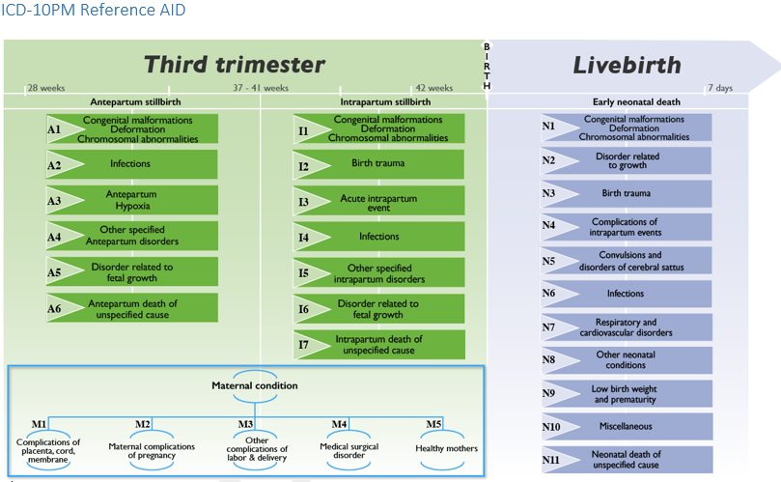

Slide 46
Example of Causes of Perinatal Death

Slide 47
How to classify according to ICD-PM classification
1. Identify type of perinatal death:
Antepartum: before the onset of labour
Intrapartum: after the onset of labour and before delivery
Early Neonatal: After delivery upto 7 days after birth
2. Identify single cause of death
3. Link perinatal death with maternal condition
Eg:
Type of perinatal death: Antepartum death
Cause of death: Antepartum hypoxia (A3)
Maternal condition: Healthy mother (M5)
ICD-PM classification: A3; M5

Slide 48
Antepartum Deaths | Causes
Congenital malformations, Deformations and Chromosomal abnormalities (A1) | All congenital malformations, deformations and chromosomal abnormalities
Infections (A2) | Congenital syphilis Congenital viral diseases Congenital infectious and parasitic diseases (TB, toxoplasmosis malaria etc) Other infections of perinatal period (intra-amniotic infection)
Antepartum Hypoxia (A3) | Intrauterine hypoxia
Other specified Antepartum disorder (A4) | fetal blood loss, intracranial non-traumatic hemorrhage of fetus & newborn, hemolytic disease/ DIC/perinatal hematological disorders, necrotising enterocolitis of fetus & newborn, congenital renal failure, complications of intrauterine procedure (not classified elsewhere)

Slide 49
Antepartum Deaths Contd…. | Causes
Disorders related to fetal growth (A5) | Light for gestational age, small for age, fetal malnutrition, growth retardation, large baby, heavy for age, post-term but not heavy for age,
Antepartum death of Unspecified cause | Fetal death and Stillborn with cause of death not known

Slide 50
Intrapartum Deaths | Causes
Congenital malformations, Deformations and Chromosomal abnormalities (I1) | All congenital malformations, deformations and chromosomal abnormalities
Birth trauma (I2) | Intracranial laceration & hemorrhage due to birth trauma, birth injuries to CNS, birth injury to scalp, birth injury to skeleton,
Acute Intrapartum event (I3) | Intrauterine hypoxia
Infections (I4) | Congenital viral disease, congenital infectious & parasitic diseases (congenital TB, toxoplasmosis, malaria,etc), intra-amniotic infection of fetus

Slide 51
Intrapartum Deaths Contd…
Other specified Intrapartum disorder (I5) | fetal blood loss, intracranial non-traumatic hemorrhage of fetus & newborn, hemolytic disease/ DIC/perinatal hematological disorders, necrotising enterocolitis of fetus & newborn, congenital renal failure, complications of intrauterine procedure (not classified elsewhere), hydrops fetalis due tyo hemolytic disease,
Disorders related to Fetal growth (I6) | Light for gestational age, small for age, fetal malnutrition, growth retardation, large baby, heavy for age, post-term but not heavy for age, extreme immaturity
Intrapartum death of unspecified cause 9I7) | Fetal death and Stillborn with cause of death not known

Slide 52
Neonatal Deaths | Causes
Congenital malformations, deformations and chromosomal abnormalities (N1) | Congenital malformations, deformations and chromosomal abnormalities
Disorders related to fetal growth (N2) | Light for gestational age, small for age, fetal malnutrition, growth retardation, large baby, heavy for age, post-term but not heavy for age, extreme immaturity
Birth trauma (N3) | Intracranial laceration & hemorrhage due to birth trauma, birth injuries to CNS, birth injury to scalp, birth injury to skeleton,
Complications of intrapartum events (N4) | Intrauterine hypoxia, birth asphyxia,

Slide 53
Neonatal Deaths | Causes
Convulsions and disorders of cerebral status (N5) | Convulsions of newborn, neonatal cerebral ischemia, neonatal coma,other disturbances of cerebral status of newborn
Infections (N6) | Tetanus neonatorum, congenital syphilis, meningitis, encephalitis, myelitis and encephalomyelitis, intracranial and intraspinal abscess and granuloma, intracranial and intraspinal phlebitis and thrombophlebitis, congenital pneumonia, congenital viral disease, bacterial sepsis of newborn, other congenital infectious and parasitic diseases, other infections specific to perinatal period (neonatal infective mastitis/conjunctivitis/intraamniotic infection)

Slide 54
Neonatal Deaths | Causes
Respiratory and cardiovascular disorders (N7) | Respiratory distress of newborn, neonatal aspiration syndromes, interstitial emphysema and related conditions, pulmonary hemorrhage originating in the perinatal period,Chronic respiratory disease originating in the perinatal period,other respiratory conditions originating in the perinatal period (atelectasis, sleep apnea, respiratory failure. Cardiovascular disorders originating in the perinatal period(cardiac failure/dysrhythmia/hypertension)

Slide 55
Neonatal Deaths | Causes
Other neonatal conditions (N8) | Fetal blood loss, umbilical hemorrhage, intracranial non-traumatic hemorrhage, hemorrhagic disease, hemolytic disease, hydrops fetalis due to hemolytic disease, kernicterus, neonatal jaundica due to excessive hemolysis / other causes, DIC, intestinal obstruction, necrotizing enterocolitis, digestive system disorder, hypothermia, disturbance of temperature regulation, conditions of skin, feeding problems, reactions and intoxications, disorders of muscle tone
Low birth weight and prematurity (N9) | Low birth weight and prematurity
Miscellaneous (N10) | Congenital renal failure, withdrawal symptoms from maternal use of drugs/ therapeutic use of drugs, termination of pregnancy affecting fetus & newborn, complications of intrauterine procedures
Neonatal death of unspecified cause (N11)

Slide 56
Maternal Causes of Perinatal Death | Causes
Complications of placenta, cord and membranes (M1) | Fetus and newborn affected by: placenta praevia/abruptio placenta/ accidental hemorrhage/ APH/ damage to placenta/ maternal blood loss/ premature separation of placenta/ morphological and functional abnormalities of placenta/ prolapsed cord/ placental transfusion syndrome/ cord compression/ unspecified conditions of cord/ chorioamnionitis/ membrane abnormalities
Maternal complications of pregnancy (M2) | Fetus and newborn affected by: maternal complications of pregnancy (incompetent cervix/premature rupture of membrane/ oligohydramnios/ polyhydramnios/ ectopic pregnancy/ multiple pregnancy/ other maternal complications of pregnancy

Slide 57
Maternal Causes of Perinatal Death | Causes
Other complications of labor and delivery (M3) | Fetus and newborn affected by: complications of labour & delivery (breech delivery & extraction/ malposition/ malpresentation/ forceps delivery/ caesareans ection/ abnormal uterine contraction/ other complications of labour & delivery
Maternal medical and surgical conditions; Noxious influences (M4) | Fetus and newborn affected by: maternal conditions that may be unrelated to present pregnancy (maternal hypertension/ renal and urinary tract disease/ infectious & parasitic diseases/ circulatory & respiratory diseases/ medical procedures/ noxious influence transmitted via palcenta or breast milk/ maternal anesthesia & analgesia during labour & delivery/ medications/ tobacco use/ alcohol use/ use of drugs of addiction,
No maternal condition identified (M5) (Healthy mother)

Slide 58
Case scenario 1
1. 31-year-old, gravida 5, para 4, hemoglobin 11 gm./dl, VDRL ++, 8 months since last menstrual period, complains of decreased fetal movement. No fetal heart rate on admission, labor induction started, delivered a stillborn baby weighing 2100 grams with signs of maceration of the skin.
What is the outcome of pregnancy (type of perinatal death) ?:
Antepartum SB
b. Cause of perinatal death:
Infection (A2)
c. Maternal condition identified:
Medical surgical disorder (M4)
d. ICD-PM:
A2 ; M4
Notes:
Pregnancy outcome: Antepartum SB

Slide 59
Case scenario 2
35-year-old pregnant woman with diagnosis of gestational diabetes with a gestational age of 42+ weeks of pregnancy complains of decreasing fetal movements. FHR was found to be 190 per minute on auscultation. A decision to perform an emergency caesarean section was taken. Baby showed no signs of life at birth and was covered with meconium.
a. What is the outcome of pregnancy (Type of perinatal death)?:
Intrapartum SB
b. Cause of perinatal death :
Acute Intrapartum event (I3)
c. Maternal condition identified:
Medical surgical disorder (M4)
d. ICD-PM:
I3 ; M4

Slide 60
Case scenario 3
A 19-year-old para 1 at 38 WOG, presented in a healthy condition during labor with no significant history. A 2450 g baby was delivered after an 8-hour labor. An early neonatal death on day 2 of life from meconium aspiration syndrome occurred. No maternal identified at the time of perinatal death.
a. What is the outcome of pregnancy (type of perinatal death)?: ?:
Early Neonatal Death
b. Cause of perinatal death:
Respiratory and cardiovascular disorders (N7)
c. Maternal condition identified:
No Medical condition identified (M5)
d. ICD-PM:
N7 ; M5

Slide 61
Case scenario 4
A 30-year-old para 1 presented in labor at 39 weeks of gestation, with the fetus alive at admission. There was poor progress in labor, with incorrect interpretation of the partograph. An acute intrapartum event occurred with a hypoxic intrapartum stillbirth. The fetus was delivered via caesarean section.
a. What is the outcome of pregnancy (type of perinatal death)?: ?:
Intrapartum Death
b. Cause of perinatal death:
Intrauterine hypoxia (I3)
c. Maternal condition identified:
Obstructed labor (M3)
d. ICD-PM:
I3 ; M3

Slide 62
नेपाल सरकार
स्वास्थ्य तथा जनसंख्या मंत्रालय
स्वास्थ्य सेवा विभाग
परिवार कल्याण महाशाखा
Every Mother and Child Counts

