Slide 1
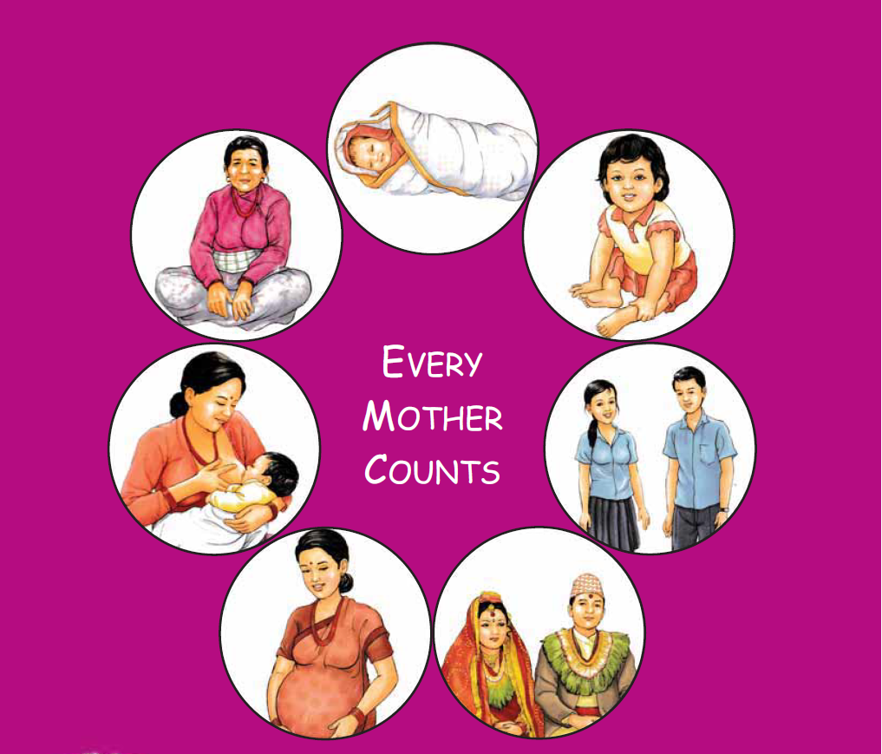
Maternal and Perinatal Death Surveillance and Response [MPDSR] - Key Terminologies -
Every Mother and Child Counts
Every Mother and Child Counts
नेपाल सरकार
स्वास्थ्य तथा जनसंख्या मंत्रालय
स्वास्थ्य सेवा विभाग
परिवार कल्याण महाशाखा

Slide 2
Objective
By the end of session, the participants will be able to define terms related to maternal and perinatal deaths.

Slide 3
Quiz Contest
Divide into four groups
Select team leaders for each group
Ground rules

Slide 4
Quiz Contest
Ground rules
There are 16 questions
Ten marks for answering the question first asked
If the group is not able to answer then the question is transferred to next group
Five marks for answering the transferred question
If correct answer does not come from the contestants, facilitator will answer
15 seconds for questions first asked and 10 seconds for transferred question
Group which attains the highest score will be the winner
Decision made by the facilitator will be the final decision

Slide 5
Question no. 1
What is the full form of MMR in MPDSR?
Answer: Maternal Mortality Ratio

Slide 6
Question no. 2
What is the denominator of MMR?
Answer: Total live births

Slide 7
Question no. 3
What is the multiplier of MMR?
Answer: 1,00,000
Notes:
MMR refers to the number of maternal deaths during a given time period per 100 000 live births during the same time period.
The WHO estimate for MMR in Nepal in 2015 was 258 deaths per 100 000 live births

Slide 8
Question no. 4
According to Maternal Mortality Study 2021, what is the MMR of Nepal?
Answer: 151 per 1,00,000 live births

Slide 9
Question no. 5
Death of women while pregnant or within 42 days of termination of pregnancy irrespective of cause of death is known as
Answer: Pregnancy related death

Slide 10
Question no. 6
Which period is referred as perinatal period?
Answer: From 28 weeks of pregnancy to 7 days after birth

Slide 11
Question no. 7
Expulsion of a dead fetus weighing 1000 gm or at/after 28 weeks of gestation is known as?
Answer: Still birth

Slide 12
Question no. 8
If a woman died during pregnancy or within 42 days of termination of pregnancy due to pregnancy related causes or other conditions aggravated by pregnancy or its management, what is this known as?
Answer: Maternal death
Notes:
(ICD-10)

Slide 13
Question no. 9
Death of a woman resulting from obstetric complications of the pregnant state is known as
Answer: Direct Maternal Death

Slide 14
Question no. 10
Death of pregnant women after 42 days of termination of pregnancy within one year is known as
Answer: Late Maternal Death

Slide 15
Question no. 11
Process of identifying cause of death using oral interview of relatives / friends / neighbours is known as
Answer: Verbal Autopsy

Slide 16
Question no. 12
Death of a woman due to previous existing condition/disease aggravated by pregnancy is known as
Answer: Indirect Maternal Death

Slide 17
Question no. 13
Death of fetus at/after 28 weeks of pregnancy or weighing more than 1000 gm up to 7 days following birth is known as
Answer: Perinatal Death

Slide 18
Question no. 14
Death of neonate within 7 days of delivery is known as
Answer: Early Neonatal Death
Notes:
1-7 days : ENND
8-28 days: Late NND

Slide 19
Question no. 15
The pathological condition that initiates the chain of events leading to death is known as
Answer: Primary Cause of Death
(or Underlying cause of death)

Slide 20
Question no. 16
A pregnant woman, referred from another hospital, was brought dead in emergency department. The referral slip had documented high BP, albumin in urine and seizure. What could be the primary cause of death?
Answer: Eclampsia

Slide 21
Tie Breaker Questions

Slide 22
Question no. 17
A young primi gravida delivered in hospital two hours back which was followed by hemorrhage. She looked very pale (Hb was 5 gm%) with un-recordable BP & pulse and she died suddenly. What could be the direct cause of death?
Answer: Haemorrhage

Slide 23
Question no. 18
What is the contributory factor leading to the maternal death in question number 17?
Answer: Anemia

Slide 24
Question no. 19
A 36 year pregnant woman who had been complaining of shortness of breath with simple house hold work and occasional chest pain and palpitation was brought to ER in labour. Immediately after delivery her shortness of breath worsened and B/L crepitation was noted on auscultation. Suddenly she started gasping and collapsed. What is the primary cause of death?
Answer: Heart Disease

Slide 25
Question no. 20
Is the death in question number 19 maternal death?
Answer: Yes, it is Maternal Death

Slide 26
Definitions

Slide 27
Death of woman of reproductive age (WRA)
Death of a woman in reproductive years, usually 15–49 years
For MPDSR-Nepal, WRA = 12-55 years
Pregnancy-related death
The death of a woman while pregnant or within 42 days of termination of pregnancy, irrespective of the cause of death.
(ICD-10)
Notes:
Pregnancy-related death
The death of a woman while pregnant or within 42 days of termination of pregnancy, irrespective of the cause of death. Includes accidental and incidental; causes
Maternal death
The death of a woman while pregnant or within 42 days of termination of pregnancy,
from any cause related to or aggravated by the pregnancy or its management, irrespective of the duration and site of the pregnancy, but not from accidental or incidental causes.
Late maternal death
The death of a woman from direct or indirect obstetric causes, more than 42 days, but less than one year after termination of pregnancy.

Slide 28
Pregnancy Related Deaths
Pregnancy Related Death
(WRA 12-55yrs)
Maternal Death
Coincidental (Accidental / Incidental) Death
(ICD-MM 9)
Direct
(ICD-MM 1 to 6)
Indirect
(ICD-MM 7)
Unspecified
(ICD-MM 8)
Notes:
Pregnancy-related death
The death of a woman while pregnant or within 42 days of termination of pregnancy, irrespective of the cause of death. Includes accidental and incidental; causes- accident, homicide, insect bite, snake bite, (NOT SUICIDE)
Maternal death
The death of a woman while pregnant or within 42 days of termination of pregnancy,
from any cause related to or aggravated by the pregnancy or its management, irrespective of the duration and site of the pregnancy, but not from accidental or incidental causes.
Late maternal death
The death of a woman from direct or indirect obstetric causes, more than 42 days, but less than one year after termination of pregnancy.

Slide 29
Maternal death
The death of a woman while pregnant or within 42 days of termination of pregnancy,
From any cause related to or aggravated by the pregnancy or its management, irrespective of the duration and site of the pregnancy,
But not from accidental or incidental causes.
(ICD-10)
Notes:
Maternal death
The death of a woman while pregnant or within 42 days of termination of pregnancy,
from any cause related to or aggravated by the pregnancy or its management, irrespective of the duration and site of the pregnancy, but not from accidental or incidental causes.
Late maternal death
The death of a woman from direct or indirect obstetric causes, more than 42 days, but less than one year after termination of pregnancy.

Slide 30
Definitions contd..
Maternal deaths can be further classified into Direct or Indirect
Direct maternal death: those resulting from obstetric complications of the pregnant state (i.e. pregnancy, delivery and postpartum), interventions, omissions, incorrect treatment, or a chain of events resulting from any of the above.
Indirect maternal death: those resulting from previously existing diseases, or from diseases that developed during pregnancy and that were not due to direct obstetric causes but aggravated by physiological effects of pregnancy.
Notes:
Direct: For example, deaths due to obstetric haemorrhage or hypertensive disorders in pregnancy, or those due to complications of anaesthesia or caesarean section.
Indirect: For example, deaths due to aggravation of an existing cardiac or renal disease (includes death due to COVID 19)

Slide 31
Definitions contd..
Late maternal death
The death of a woman from direct or indirect obstetric causes, more than 42 days, but less than one year after termination of pregnancy.
(ICD-10)
Notes:
Late maternal death
The death of a woman from direct or indirect obstetric causes, more than 42 days, but less than one year after termination of pregnancy.

Slide 32
Example 1:
A 24 year old woman delivered a large healthy baby at home. Two hours after delivery she was bleeding heavily with a fast pulse and low blood pressure. She died four hours after delivery.
Q1. Is this a maternal death?
Yes
Q2. If yes, can it be classified as Direct / Indirect
Direct (Haemorrhage)
Q3. Should it be reported to MPDSR committee?
Yes
Notes:
There may be some disagreements or ambiguities – not all cases are easy to classify!
Remember that the purpose is to assess whether the death is likely to be a maternal death and thus require a verbal autopsy. Participants should NOT try to diagnose the condition described or assign a cause of death.
Try to prevent participants’ getting too preoccupied with specific examples or asking about scenarios that are likely to be extremely rare. As long as standardized classification are applied to most deaths, the system will function.

Slide 33
Example 2:
A 36 year old woman is known to be about 6 months pregnant with her 5th pregnancy. She experiences dizziness and night sweats, shortness of breath and has been coughing blood stained sputum. The Doctor diagnosed tuberculosis and found she was HIV positive. She died at 7 months pregnancy of pneumonia.
Q1. Is this a maternal death?
Yes
Q2. If yes, can it be classified as Direct / Indirect
Indirect (HIV/TB are affected physiologically by pregnancy)
Q3. Should it be reported to MPDSR committee?
Yes, it should be reported

Slide 34
Example 3:
A 31 year old woman is 38 weeks pregnant with her 4th child. She is on her way to the local town walking along the main road with her children when a bus knocks her down. She is unconscious and dies 4 hours after the accident.
Q1. Is this a maternal death?
No, it is not a maternal death, as the death occurred from
incidental causes
Q3. Should it be reported to MPDSR committee?
Yes

Slide 35
Perinatal Death
The death of a baby from 28 weeks of gestation (OR weighing at least 1000 grams OR Length atleast 35 cms) to first 7 days of life (early neonatal period) (ICD-10).
(This is the definition used in MPDSR-Nepal)
Notes:
From 1st day of 28th week till 28 weeks 6 days

Slide 36
Definitions
Stillbirth
A baby born with no signs of life at the time of birth, at 28 or more weeks of gestation OR weighing more than or equal to 1000 gms or length more than or equal to 35 cms. (ICD-10)
Stillbirth (Includes IUD)
Macerated Stillbirth
(Antepartum SB)
Fresh Stillbirth
(Intrapartum SB)
Intra-uterine death of fetus before the onset of labor
Intra-uterine death of fetus during labour or delivery

Slide 37
Neonatal Death
The death of a child who is born alive but dies within the first 28 days of life.
Early neonatal death
An early neonatal death is a death occurring in an infant during the first week of life (first 7 days).
Notes:
0-7 days : early neonatal death
8-28 days: late neonatal death

Slide 38
Maternal Mortality Ratio (MMR)
The number of maternal deaths during a given time period per 100 000 live births during the same time period.
According to Maternal Mortality Study 2021, MMR in Nepal is 151 deaths per 100 000 live births

Slide 39
Perinatal Mortality Rate (PMR)
The number of perinatal deaths in a particular population in a given time (usually a year) expressed as the number of deaths for each 1000 births.
Numerator= Stillbirths + ENND
Denominator= Total births
Multiplier= 1000
Notes:
Perinatal Mortality Ratio: The number of perinatal deaths in a particular population in a given time (usually a year) expressed as the number of deaths for each 1000 live births in the same population and time period.

Slide 40
Neonatal Mortality Rate (NMR)
The number of neonatal deaths in a particular population in a given time (usually a year) expressed as the number of deaths for each 1000 live births.
Numerator= ENND (birth to 7 days of life)
Denominator= Live births
Multiplier= 1000

Slide 41
नेपाल सरकार
स्वास्थ्य तथा जनसंख्या मंत्रालय
स्वास्थ्य सेवा विभाग
परिवार कल्याण महाशाखा
Every Mother and Child Counts

