Slide 1
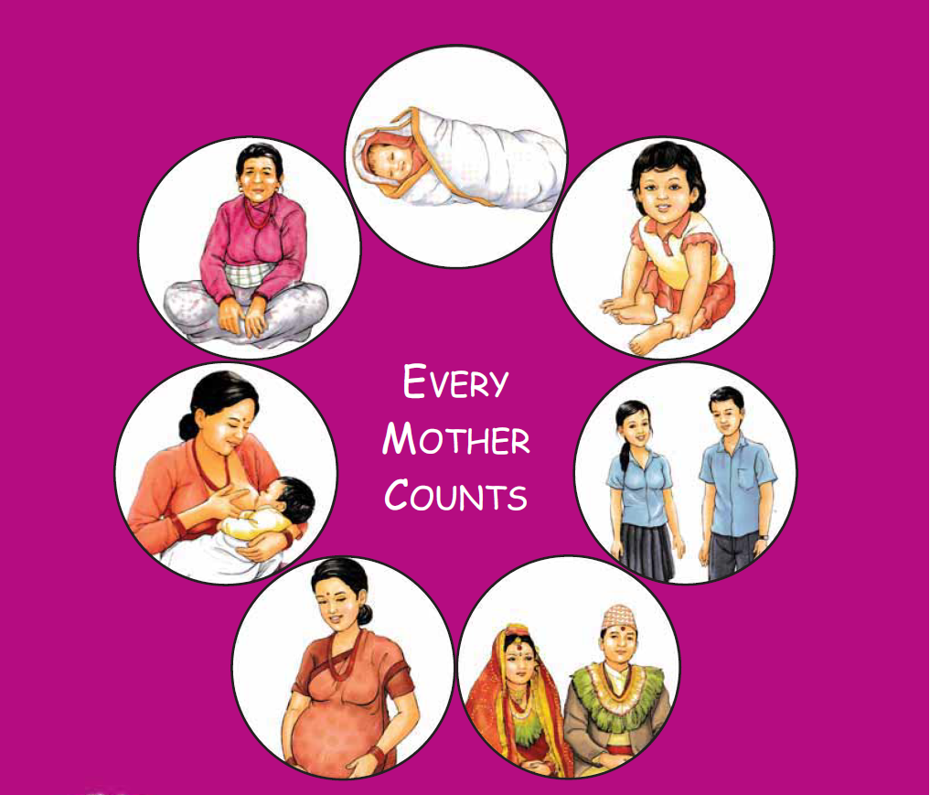
मातृ तथा पेरिनेटल मृत्यू निगरानी तथा प्रतिकार्य Maternal & Perinatal Death Surveillance and Response [MPDSR] - Why did Mrs. X die?-
Every Mother and Child Counts
नेपाल सरकार
स्वास्थ्य तथा जनसंख्या मंत्रालय
स्वास्थ्य सेवा विभाग
परिवार कल्याण महाशाखा

Slide 2
Watch the Video
https://www.youtube.com/watch?v=gS7fCvCIe1k&ebc=ANyPxKpbsEGR1Et8qf77_9raO6GZKLEdbSufo4xbNtlPhLwFQW6H0wxYe0DEGfjLyfDsygR9EogcA9r1hPut2wjalAWd83bL2g
And discuss …

Slide 3
The Story
This is a story of one case of maternal death. For the sake of anonymity, let us call the unfortunate woman, Mrs X.
Mrs X died during labor in a hospital at 8 months pregnancy.
It was a case of antepartum haemorrhage due to placenta praevia.
Hospital: insufficient blood supply, CS delayed
The doctor formed the diagnosis; The file of Mrs X was closed.
Notes:
Facilitator: Other discussion points
No blood for transfusion.
Delay in seeking treatment. Failure to recognize significance of antenatal bleeding.
Anemia
No ANC
Age.
Lots of children and lacked access to family planning.
Limited access to transportation.
Already Malnourished at the beginning of pregnancy.

Slide 4
When no of MD increased, Later the file was re-opened and the causes analyzed.
The analysis identified the 'avoidable factors' in facility and community.
An action plan was made and acted upon to prevent similar deaths

Slide 5
What led to Mrs's X death? Let's Discuss the Path Way to Her Death
Socio – economic status
Family status
Community health services
Access to health facility / services
Quality of health services in the facility

Slide 6
Path Way to Death
The cause of death was not just the
'Antepartum Hemorrhage'

Slide 7
What led to Mrs. X’s Death
1. Factors related to the woman, her family and community
2. Factors related to health system
Notes:
How we can improve the factors responsible for Mrs. X’s death and how we can respond to the factors and prevent death of another mother (Mrs. Y) due to the same cause in the same place.
Discussions should be guided by the fact that the causes of maternal deaths are more than only health problems.
Social determinants of health as discussed for Mrs. X are important factors.
Therefore, coordination response from multiple sectors is important to improve the system.
Sectors such as health, education, infrastructure, women development etc must work together to improve the system.

Slide 8
Factors related to the woman, her family and community
Socio-economic status: poor housewife, uneducated
Chronic anemia due to malnutrition
No FP use: Lack of access to any family planning information, education or services, and therefore may not have had the opportunity to use any method of family planning in her life
No access to any sort of prenatal care during her pregnancy, Only ONE ANC
Delay in deciding to go to facility
Access to HF / limited access to transport
Delay in arranging transport to facility due to financial constraint- 6 hrs to collect money
Poor quality of care at hospital – inadequate blood and delayed CS
Unaware of danger signs- did not seek care for APH (since early pregnancy)

Slide 9
Factors related to health system
1 ANC: Quality???? - low lying placenta not identified
Limited blood availability
Insufficient HR
Delay in appropriate management (CS)

Slide 10
Response activities

Slide 11
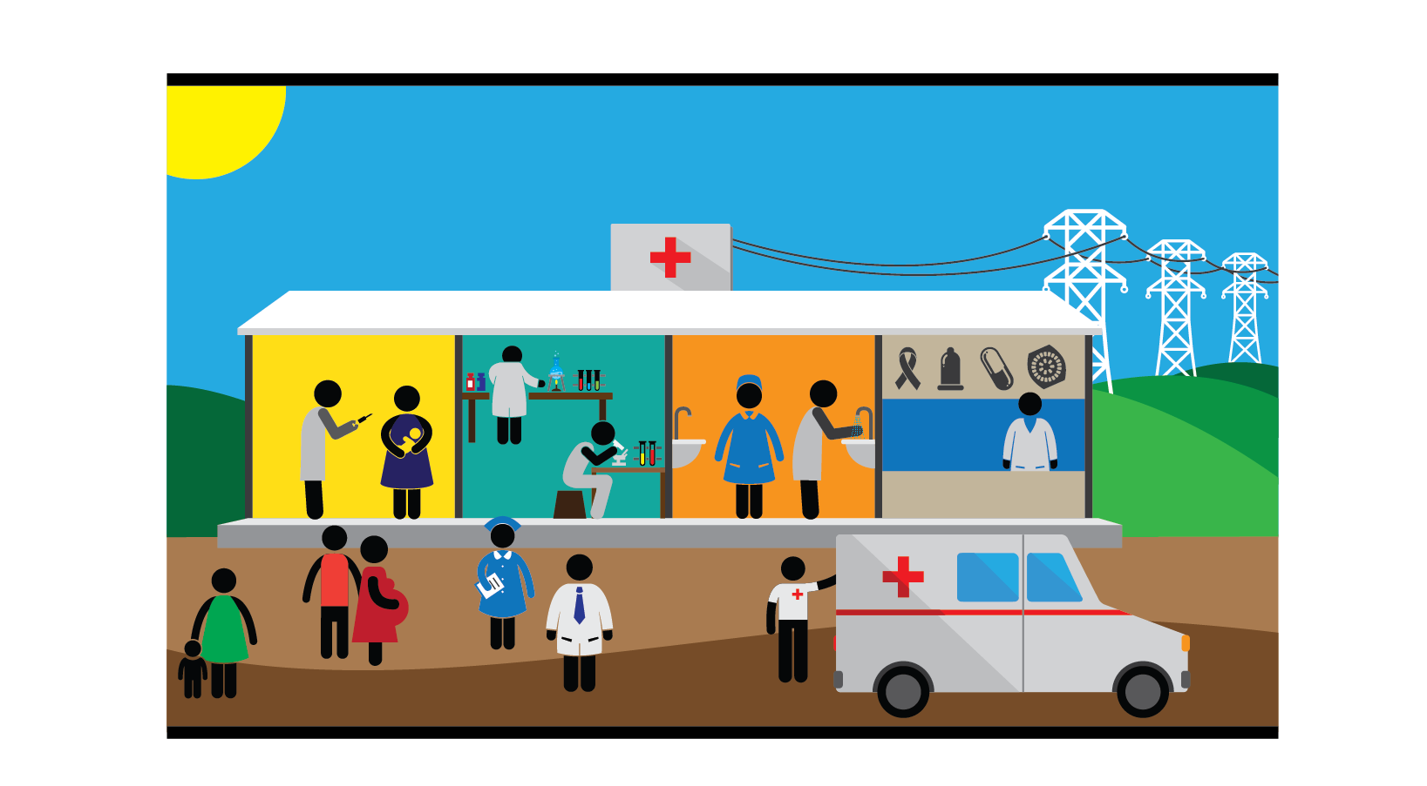
How Can Mrs Y be Saved?
Socio – economic status
Family status
Community health services
Access to health facility / services
Quality of health services in the facility

Slide 12
Response to Mrs X's Death
At health facility:
Blood bank in the hospital
(improved blood supply at hospital)
Hospital ready for emergency management
Early diagnosis/judgement and management (timely CS)
Increased number of midwives / service providers
Capacity building

Slide 13
Response to Mrs X's Death
At community:
Women empowerment activities at the community: female education
Community health services – awareness on FP, ANC, nutrition
Ambulance management

Slide 14
Any comments / feedback ?

Slide 15
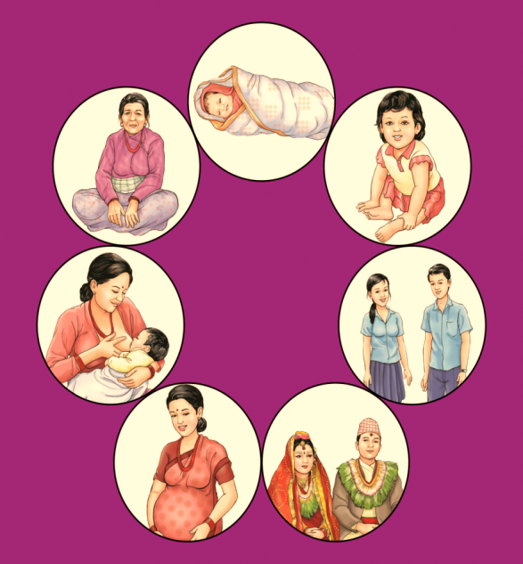
धन्यबाद
Every Mother and Child Counts

