Slide 1
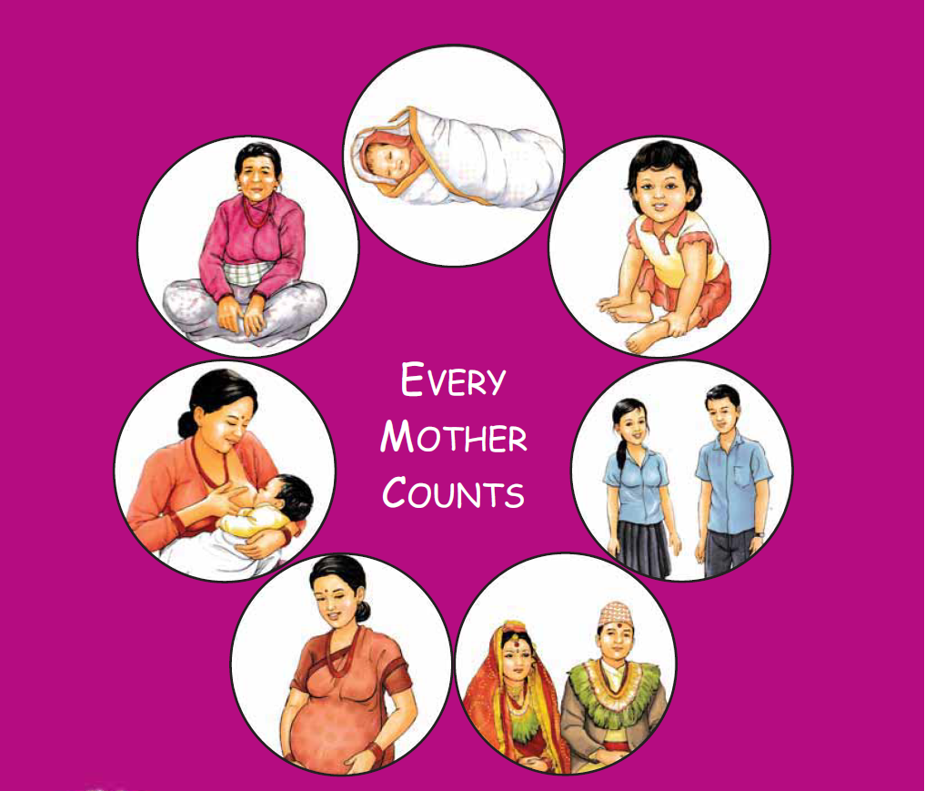
Maternal and Perinatal Death Surveillance and Response [MPDSR] - Introduction to MPDSR -
Every Mother and Child Counts
नेपाल सरकार
स्वास्थ्य तथा जनसंख्या मंत्रालय
स्वास्थ्य सेवा विभाग
परिवार कल्याण महाशाखा

Slide 2
Session Objectives
By the end of the session, the participants will be able to
Describe the status of maternal and perinatal mortality in Nepal,
Describe the rationale, goal, objectives and components of MPDSR and
Share the implementation status of MPDSR in Nepal.

Slide 3
Case Scenario
A 26-year old had her third baby at home. Her first baby died after a difficult delivery. Her second baby was premature and survived.
During this pregnancy, she attended one antenatal care at the local health center on her fifth month.
She started bleeding 1 hour after delivery of a healthy baby.
The local skilled birth attendant (SBA) came within 1 hour. She found the woman very pale and collapsed and gave her oxytocin and misoprostol and referred her to the district hospital.

Slide 4
Case Scenario contd..
Her husband refused to take her to the hospital and it took 2 hours to convince her husband.
She died on the way to hospital.
Her family and the village grieved for her death.
2. After three months, another maternal death occurred in the village due to similar cause of hemorrhage.

Slide 5
Questions
What was the cause of the first mother’s death?
Was her death preventable? How?
What could have been done to prevent the second mother’s death?

Slide 6
Background
Development of any country is reflected by the status of health of mothers and children
Notes:
Death of a mother brings devastating results to the family and the society and most of these deaths are preventable

Slide 7
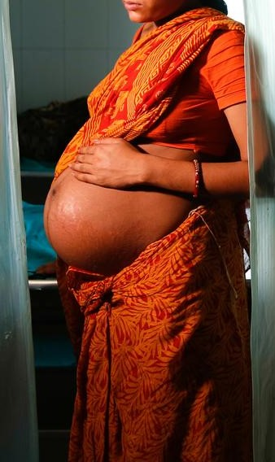
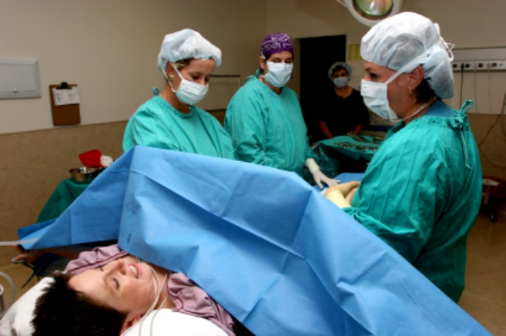
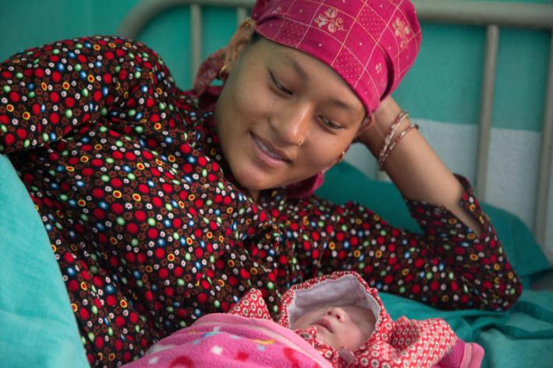
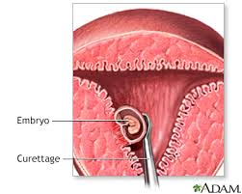
Maternal Mortality: What & How Much Is It?
During Pregnancy
During Delivery
During Postpartum Period
During / After Abortion
Globally, about 3 lakh women die every year due to maternal cause
99% of such maternal deaths occur in less developed countries
Maternal Morality Study 2021: In Nepal, 622 maternal deaths
(653 Pregnancy Related Deaths)
Notes:
बिश्व स्वास्थ्य संगठनको सन् २०१५ को अनुमान अनुसार संसार भरि प्रत्यक बर्ष ३ लाख जति महिला गर्भ सम्बन्धि जटिलताले मर्ने गर्दछन जस मध्ये ९९ प्रतिसत कम बिकसित मुलुकका रहेका छन्
यो तथ्यांक अनुसार नेपालमा प्रत्यक बर्ष १७०० जति महिला गर्भ सम्बन्धि जटिलताले मर्ने गर्दछन
समयमै राम्रो उपचार दिन सके अधिकांश मातृ मृत्यू रोक्न सकिन्छ

Slide 8
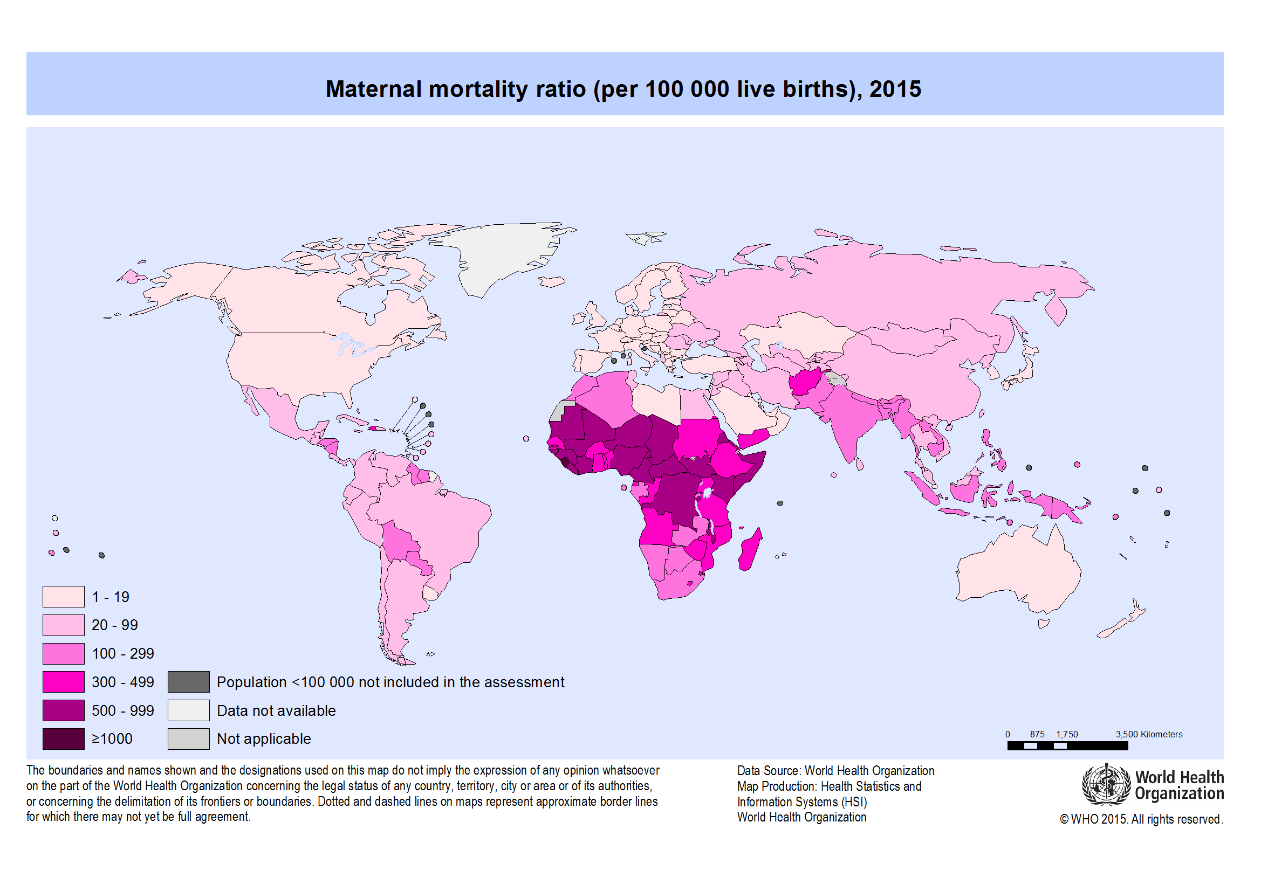
MMR: Where are we
Italy, Belarus, Norway, Poland | 2
Greece, Israel | 3
Spain, Sweden | 4
Australia, Belgium, Japan, Netherland, Switzerland | 5
China | 29
South Sudan | 1150
Sierra Leone | 1120
Nigeria | 917
Bangladesh | 173
India | 145
Nepal | 174
Nepal
151
Source: Trends in Maternal Mortality, 1990 -2020, WHO, UNICEF,UNFPA, WB
Post Census Maternal Mortality Study 2021
Notes:
Pregnancy Related Mortality (NDHS-2016)= 259 / 100,000 live births – for comparison with previous years.
Maternal Mortality (NDHS-2016)= 239 / 100,000 live births

Slide 9
Questions answered by Maternal Death Review
Who are dying?
Where are women dying?
When (stage of pregnancy) are women dying?
What is the main cause of death?

Slide 10
Rationale of MPDSR
Sustainable Development Goals has targets to reduce MMR to 70 per 100000 live births by 2030.
Institutional delivery to 90% by 2030.
It is possible to achieve the targets if MPDSR is effectively implemented.
Notes:
* MICS 2019: 77.5% Institutional delivery
Even though the MMR reduced considerably, Nepal could not achieve the MDG of 134 MMR by 2015. As per the WHO estimate, MMR was 258 in 2015. But the targets set by SDG for MMR is ambitious, and we need to have targeted intervention to reduce the MMR to 70 by 2030. MPDSR is a strong proven system which can guide and assist in preventing maternal deaths and reduce MMR.

Slide 11
Maternal and Perinatal Mortality
Perinatal deaths (MPDSR)
(FY 2077/78)
Total reported: 944
Stillbirth: 726 Antepartum: 522
Intrapartum: 204
MNH Section, Family Welfare Division, 2077/78
MoHP, NSO. (2022). National Population and Housing Census 2021: Nepal Maternal Mortality Study 2021. Kathmandu: Ministry of Health and Population; National Statistics Office.

Slide 12
Maternal Mortality (MMS 2021)
MoHP, NSO. (2022). National Population and Housing Census 2021: Nepal Maternal Mortality Study 2021. Kathmandu: Ministry of Health and Population; National Statistics Office.

Slide 13
MPDSR: Definition
Continuous identification, notification, quantification and determination of causes and avoidability of all maternal and perinatal deaths, as well as the use of this information to respond with actions that will prevent future deaths

Slide 14
MPDSR: Goal
“To eliminate preventable maternal and perinatal mortality by obtaining and using information on each maternal and perinatal death to guide public health actions and monitor their impact”
Notes:
MPDSR can contribute significantly to a country’s “culture of accountability” by connecting action with results.

Slide 15
MPDSR: Objectives
To count every maternal and perinatal death, permitting an assessment of the true magnitude of maternal and perinatal mortality and the impact of actions to reduce it.
To provide information that effectively guides immediate as well as long-term actions to reduce maternal mortality at health facilities and community and perinatal mortality at health facilities.

Slide 16
Components of MPDSR
1. Identify cases & notify
2. Collect Information
4. Recommend solution
5. Implement solution
6. Monitor, Evaluate & Refine
3. Analyze information

Slide 17
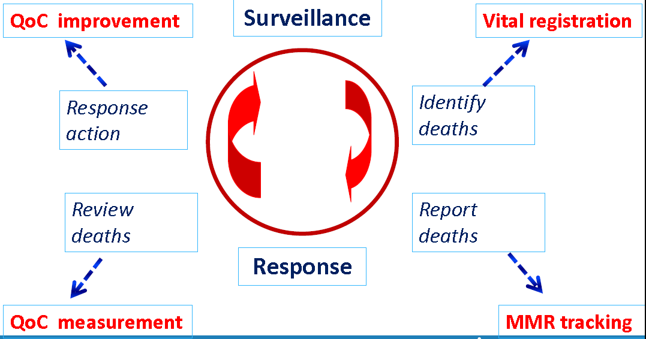
MPDSR and QoC
MDSR can improve the quality of care provided to pregnant women by identifying gaps in health services that contributed to a maternal death.
Notes:
Implementing MPDSR also strengthens other processes in the health system. Identifying deaths can enhance vital registration, reporting maternal deaths in community and health facility helps in tracking of maternal mortality, reviewing the maternal and perinatal deaths can assist in reviewing the quality of care at different level and implementing the response improves the quality of care.
It complements the system of national systems for civil registration and vital statistics (CRVS) and health management information systems (HMIS). The system will generate reliable data on the rate and causes of maternal mortality – and so act as a cornerstone for a national CRVS system.
It has been estimated that reported maternal mortality underestimates the true magnitude by up to 30% worldwide and by 70% in some countries. An effective MDSR system will produce more accurate and complete estimates of maternal mortality, providing robust and consistent data for a country’s CRVS system.

Slide 18
Key Principles / Concepts of MPDSR
No woman should die giving birth
Every death counts
Beyond the numbers
Not used for litigation
No blame
No name
No punitive action
Black Box
Every death has a lesson
Notes:
Most of the maternal deaths are preventable. 99% of these deaths occur in less developed regions.
Death of every mother causes enormous burden and sorrow to the family and society.
Death should be reviewed not only in terms of quantity but importance must be given to review of quality of service the woman received at different levels.
The review process is not to disclose name of any person.
The review process is not to blame any person. MPDSR requires an enabling environment – one of collaboration rather than blame.
The documents and process is not to be used for any legal process.
The review process is not to be used to punish anyone.
From television shows we learn how experts go into great depth to find the exact cause of each airplane crash and near-crash. They do so to make flying even safer in the future. It is the same line of thinking that is behind the concept of Maternal Death Surveillance and Response.
Even though there can be similar causes of maternal deaths, each death is unique and the social determinants of each death will be different with unique lessons for the program managers. So each death should be reviewed and responded.

Slide 19
Implementation status
1990 MDR
Maternity Hospital
1996 MPDR 6
Hospitals
2009 MPDR 12
Hospitals
2012 MPDR 21
Hospitals
2013 MPDR 42
Hospitals
2015 MPDSR
National Guideline
2016 Community MPDSR 6
Districts
2020
14 Districts 77 hospitals
2022: MPDSR in 27 Districts & 94 hospitals
Notes:
2021: 14 districts and 93 hospitals

Slide 20
MPDSR Implementing Facilities and Districts
Hospitals: 94
Districts: 27

Slide 21
Maternal and Perinatal Death Surveillance and Response [MPDSR] - MPDSR Situation Analysis-
Every Mother and Child Counts
नेपाल सरकार
स्वास्थ्य तथा जनसंख्या मंत्रालय
स्वास्थ्य सेवा विभाग
परिवार कल्याण महाशाखा

Slide 22
Findings from MPDSR 2078 / 79 (N=178)

Slide 23
MPDSR लागु भएका अस्पतालहरुको प्रतिवेदनको अवस्था (N=94)
MPDSR Implementation Status in Hospitals (N=94)
Notes:
Reporting includes ZERO reporting

Slide 24
MPDSR लागु भएका जिल्लाहरुको प्रतिवेदनको अवस्था (N=27)
MPDSR Implementation Status in Districts (N=27)

Slide 25
प्रदेश तहमा मातृ मृत्युको विवरण (N=178)
Maternal Death Reporting in Provinces
(N=178)

Slide 26
Age at Death (N=178)

Slide 27
को ?: जनजातिहरुमा अधिकतम मृत्यु (N=178)
Who are dying? (N=178)
Notes:
Some ethnic groups have lower accessibility and acceptability to health services due to various reasons such as religious norms, geographical situation which cause higher MMR.

Slide 28
सुत्केरी भएको स्थान (N=178)
Place of Delivery (N=178)

Slide 29
मृत्युको समय (N=178)
Period of Death
(N=178)

Slide 30
मृत्यु भएको स्थान (N=178)
Place of Death (N=178)

Slide 31
Cause of Death (N=178)

Slide 32
Perinatal Death Reporting Status by Province (N=1646)

Slide 33
Perinatal Death Distribution (N=1646)

Slide 34
Final cause of Perinatal Death (N=1646)

Slide 35
Challenges to MPDSR Implementation
Lack of ownership at various levels
Under reporting of maternal deaths
Blame culture at some places that inhibits health professionals and others from participating fully in the MPDSR process
Inadequate staff numbers, resources and budget
Problems of geography and infrastructure.
Delay in review of Maternal deaths
Delay/Incomplete notification, screening, VA, review, response & use of web-based MPDSR system
Transition into federal system brings need to change in national guidelines as well as orientation and trainings in provincial and local levels.
Notes:
Some barriers identified during implementation of MPDR in hospitals.

Slide 36
Actions taken following MPDSR review
Central level:
Strengthening of MPDSR in hospitals and districts through refresher orientations and onsite coaching
Expansion of MPDSR in hospitals and districts
Plan to develop PPH and Pre-eclampsia / eclampsia package
Hospitals:
Orientation to resident doctors and nurses of different departments on MPDSR
All interns, junior residents and nurses trained in neonatal resuscitation
24 hrs on floor duty for faculty doctors for prompt management and additional nursing staff in labor room for better monitoring
Mandatory 24 hr duty for Obstetricians and Gynaecologists and
Mandatory 24 hr duty for Medical Officers in maternity wards and NICU

Slide 37
Hospitals:
Pediatricians to attend all deliveries
Increase in number of delivery tables, patient beds and dedicated beds for neonatal care
MICU with ventilator within Obstetrics and Gynaecology department
Plan to establish/upgrade infrastructure for birthing unit/SNCU in referral hospital
Strengthening referral mechanism: circulate phone numbers of referral hospitals in hospitals
Availability of emergency medicines, equipment, and adequate necessary instruments
Mandatory to call the hotline number of CEONC hospitals before referral
Presence of a healthcare worker during referral- as far as possible
To conduct regular CME for skill update

Slide 38
Hospitals:
Increase in number of staff for ANC to improve quality service
Emphasis on counseling for prenatal screening of mother during ANC visits
Mandatory to do ECG in all cases with high blood pressure and those requiring caesarean section
Plan to establish/upgrade infrastructure for birthing unit/SNCU in referral hospital
Strengthening referral mechanism: circulate phone numbers of referral hospitals in hospitals
Availability of emergency medicines, equipment, and adequate necessary instruments
Mandatory to call the hotline number of CEONC hospitals before referral
Presence of a healthcare worker during referral- as far as possible
To conduct regular CME for skill update

Slide 39
Local level:
Free calcium to pregnant women in some local levels
Established fund for poor in some local levels
Depending on economic condition, one side travel to CEONC site free of cost during referral
Free ambulance for maternity cases in some local levels
Initiated “Upa-mayor Koseli Karyakram”- hygiene kit/ nutrition package/ package for newborns and mothers
Recruitment of Obstetrician and Gynaecologist at local level facility
Initiated specialized mobile clinic every month
Plan for establishment of birthing centre at wards with maximum maternal deaths
To initiate “Khushaal pariwaar” program for high-risk group in some local levels: from conception till vaccination of children

Slide 40
नेपाल सरकार
स्वास्थ्य तथा जनसंख्या मंत्रालय
स्वास्थ्य सेवा विभाग
परिवार कल्याण महाशाखा
Every Mother and Child Counts

