Slide 1
Maternal and Perinatal Death Surveillance and Response [MPDSR] - Monitoring and Evaluation
Every Mother and Child Counts
Every Mother and Child Counts
नेपाल सरकार
स्वास्थ्य तथा जनसंख्या मंत्रालय
स्वास्थ्य सेवा विभाग
परिवार कल्याण महाशाखा
Notes:
This session deals with importance of monitoring and evaluation in effective implementation of MPDSR system and use of the data in improving quality of care and strengthening the health care delivery system

Slide 2
Objectives
By the end of this session, participants will be able to:
Describe importance of monitoring MPDSR process and using the data in improving quality of care
Analyze & interpret maternal and perinatal death data
Use MPDSR data/information to produce local solutions to the root causes of maternal and perinatal deaths
Understand the role of monitoring of the process and the actions to ensure effective response to address the identified avoidable factor

Slide 3
MPDSR monitoring

Slide 4
MPDSR Monitoring checklist for hospitals
MPDSR monitoring checklist for hospitals
Maternal and Perinatal Death Surveillance and Response Activities at Hospitals
Name of the Hospital: District:
SN | Requirements | Yes | No | Remarks
1. | MPDSR Committee |  |  | Number of meetings conducted:
2. | Data (……………… to ……………………….)
 | Total deliveries |  |  | Number:
 | Total live births |  |  | Number:
 | Total maternal deaths |  |  | Number:
 | Total still births |  |  | Number:
 | Total early neonatal deaths (upto 7 days after birth) |  |  | Number:
Notes:
Hospitals are expected to review all institution based maternal deaths. It is in line with the basic principle of MPDSR: Every death counts and no women should die giving birth; every death has a lesson to learn that can be used to prevent another mother dying from similar cause and reasons. Timely and effective response is the key for successful MPDSR so it is very important to monitor the actions identified and their implementation status.

Slide 5
3. | Maternal Death Review
 | MDR Form filled within 24 hours of all maternal deaths |  |  | Number:
 | MPDSR Review committee meeting within 72 hours of each maternal death |  |  | Number:
 | Action Plans developed after each maternal death review |  |  | Number:
 | Action Plans implemented after each maternal death review |  |  | Number:
 | Action plan followed up in next MPDSR review meeding |  |  | Number:
4. | Perinatal Death Review
 | PDR Form filled within 72 hours of all stillbirths and early neonatal deaths |  |  | Number:
 | Monthly MPDSR Review committee meeting to review perinatal deaths |  |  | Number:
 | Action Plans developed after each monthly perinatal death review |  |  | Number:
 | Action Plans implemented after monthly perinatal death review |  |  | Number:
 | Action plans followed up in next Monthly meeting

Slide 6
Issues identified: Actions advised: Lessons learned: Conducted by: Date: DD / MM / YYYY
5. | Reporting
 | MDR forms entered in web-based system |  |  | Number:
 | PDR Summary forms entered in web-based system |  |  | Number:
6. | Logistics
 | MPDSR Guideline
 | MDR form
 | PDR form
 | PDR summary form

Slide 7
MDSR monitoring at District
Maternal and Perinatal Death Surveillance and Response Activities at Palika
Palika: District:
SN | Requirements | Yes | No | Remarks
1. | MPDSR Committees at Health Facility
2. | FCHV orientation on MPDSR
 | Data ( ………. / ………)
1. | Total deaths notified |  |  | Number:
2. | Total deaths screened |  |  | Number:
3. | Total pregnancy-related deaths identified |  |  | Number:
4. | Total VA conducted |  |  | Number:
5. | Cause of death identified from VA |  |  | Number:
Notes:
The sections below describe the monitoring framework at different levels: from HP/PHCC to central level.
At community - HP/PHCC (VDC/Municipality) level only maternal deaths are reviewed. So HPs and PHCCs are expected to monitor deaths of all women of age 12 to 55 years to ensure that no maternal deaths are left out. It is in line with the basic principle of MPDSR: Every death counts and no women should die giving birth; every death has a lesson to learn that can be used to prevent another mother dying from similar cause and reasons.

Slide 8
6. | Cause of deaths |  |  | a. b. c. d. e.
7. | Local level MPDSR Committee meeting conducted |  |  | Number:
8. | Action plans developed after review meeting |  |  | Number:
9. | Action Plans implemented |  |  | Number:
10. | Action plans implemented:
a
b
c
d
e

Slide 9
 | Reporting
1 | Notification forms entrered in MPDSR web-based system |  |  | Number:
2. | Screening forms entrered in MPDSR web-based system |  |  | Number:
3. | VA forms entered in MPDSR web-based system |  |  | Number:
 | Logistics
1. | MPDSR Guideline
2. | Notification form
3. | Screening form
4. | VA form
I

Slide 10
Issues identified:
Lessons learned:
Impact of implementing action plans:
Conducted by: __________________ Date: DD / MM / YYYY

Slide 11
Community deaths Facility deaths
Identify all deaths of women aged 12-55, filter all suspected maternal deaths and notify to the focal point within 24 hrs of knowledge of death
Identify and notify maternal deaths to the district focal point within 24 hrs of occurrence of death
Fill MPDR form
Conduct Verbal Autopsy within 30 days of death
Conduct Maternal and Perinatal Death review and complete the MPDR form with recommendations
VA forms reviewed by concerned local level MPDSR team
At local level, VA data entry in the software
Data entry in the software, by hospital,
Data management and analysis

Slide 12
Web-based reporting System for MPDSR
Levels:
Central Level
District Level
Hospital Level
Local Level
Username and password created for all Local levels, Hospitals, Districts and Provinces.
Notes:
Web-based MPDSR System
The system is developed in, center, district, hospitals and local level.
Central level:
Family Welfare Division has access to all the data entered into the system from the districts and hospitals and is responsible for reviewing, providing feedback and approving the forms submitted.
District level:
The HOs of MPDSR implementing districts have access to view data entered by hospitals within the respective districts also.
Local Level:
The local levels need to enter the data related to maternal deaths in the community. The forms needed to enter include notification, screening, verbal autopsy and cause of death assignment forms. The forms should be entered as soon as possible.
Hospital level:
Each hospital needs to enter the Maternal Death Review (MDR) and PDR summary forms as soon as possible after the review and completion of the forms.

Slide 13
Log in pathway
Website: www.fwd.gov.np
Click MPDSR box in the home page of FWD
Insert username and password provided for individual Palika and hospital
Require Internet connection to enter the data

Slide 14
FWD Homepage

Slide 15
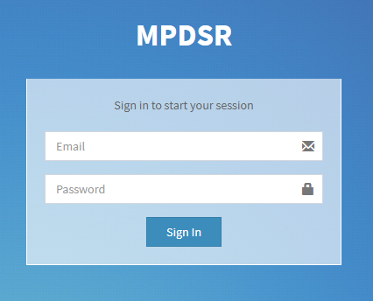
MPDSR Webpage
Notes:
Enter Username and Password

Slide 16
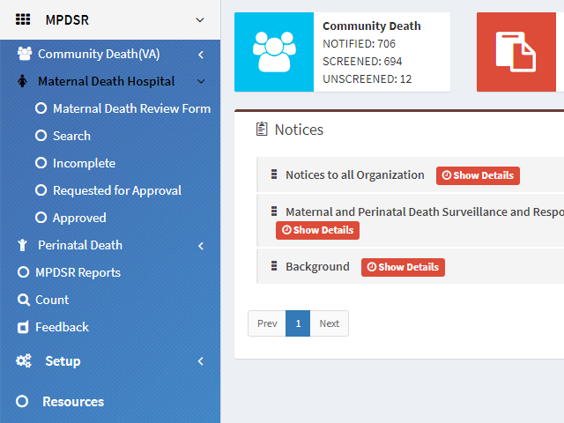
Hospital MPDSR

Slide 17
Data entry and Saving data
Click Maternal Death Review Form to fill in new Maternal death case
Click Summary of Perinatal Death Review Form to enter the monthly perinatal death summary
“Submit Data” must be clicked in order to save the data in every section.
After filling the forms please do not forget to click “Request for approval”, so that the forms can be approved or verified by FWD.
After submission the forms have to be Approved by the central level.

Slide 18
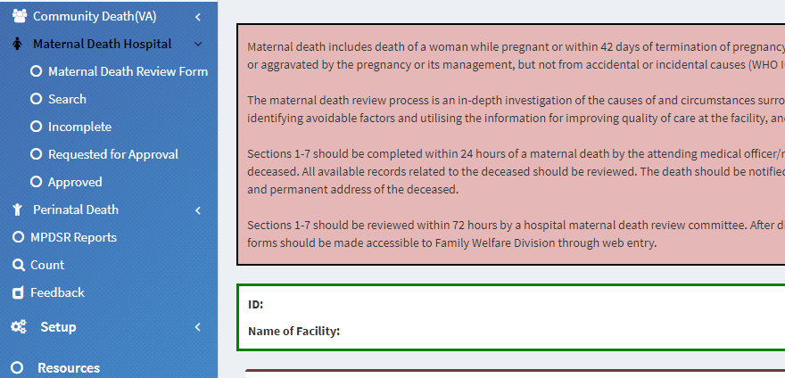
Steps of approval
Click here to view Incomplete forms, the listed forms should be completed & requested for approval.
Click here to view the forms that have been sent to FWD for approval
Click here to view the forms that are approved by FWD

Slide 19
Any comments / feedback?

Slide 20
नेपाल सरकार
स्वास्थ्य तथा जनसंख्या मंत्रालय
स्वास्थ्य सेवा विभाग
परिवार कल्याण महाशाखा
Every Mother and Child Counts

